Slide 1
OCR A-Level Computer Science
Taster lesson

Slide 2
OCR A-Level Computer Science
There are 10 types of people in the world, those who understand binary and those who don’t

Slide 3
Why choose Computer Science?
https://youtu.be/IDFAg9oluv8

Slide 4
A-Level Computer Science
Computer Science is a practical subject where students can apply the academic principles learned in the classroom to real-world systems.
It’s an intensely creative subject that combines invention and excitement, and can look at the natural world through a digital prism.
The aims of this qualification are to enable learners to develop:
An understanding and ability to apply the fundamental principles and concepts of computer science, including: abstraction, decomposition, logic, algorithms and data representation
The ability to analyse problems in computational terms through practical experience of solving such problems, including writing programs to do so
The capacity to think creatively, innovatively, analytically, logically and critically
The capacity to see relationships between different aspects of computer science
Mathematical skills.

Slide 5
Component 01: Computer systems
Students are introduced to the internal workings of the (CPU), data exchange, software development, data types and legal and ethical issues. The resulting knowledge and understanding will underpin their work in component 03.
It covers:
The characteristics of contemporary processors, input, output and storage devices
Types of software and the different methodologies used to develop software
Data exchange between different systems
Data types, data structures and algorithms
Legal, moral, cultural and ethical issues.

Slide 6
Assessment: Computer systems
Written Exam
Marks = 140
Duration = 2 hours 30 mins
Weighting = 40%
The internal workings of the (CPU), data exchange, software development, data types and legal and ethical issues.
Calculators not allowed.

Slide 7
Component 02: Algorithms and programming
This builds on component 01 to include computational thinking and problem-solving.
It covers:
What is meant by computational thinking (thinking abstractly, thinking ahead, thinking procedurally etc.)
Problem solving and programming – how computers and programs can be used to solve problems
Algorithms and how they can be used to describe and solve problems.

Slide 8
Assessment: Algorithms and programming
Written Exam
Marks = 140
Duration = 2 hours 30 mins
Weighting = 40%
Using computational thinking to solve problems.
Calculators not allowed.

Slide 9
Component 03: Programming project
Students are expected to apply the principles of computational thinking to a practical coding programming project.
They will analyse, design, develop, test, evaluate and document a program written in a suitable programming language.
The project is designed to be independently chosen by the student and provides them with the flexibility to investigate projects within the diverse field of computer science.
We support a wide and diverse range of languages.

Slide 10
Assessment: Programming project
Project (NOT controlled assessment)
Marks = 70
Duration = N/A
Weighting = 20%
Non-exam assessment. Students will be expected to:
analyse a problem (10 marks)
Design a solution (15 marks)
develop and test a solution (25 marks)
evaluate and document the project (20 marks)
The program must be written in a suitable programming language to solve it .

Slide 11
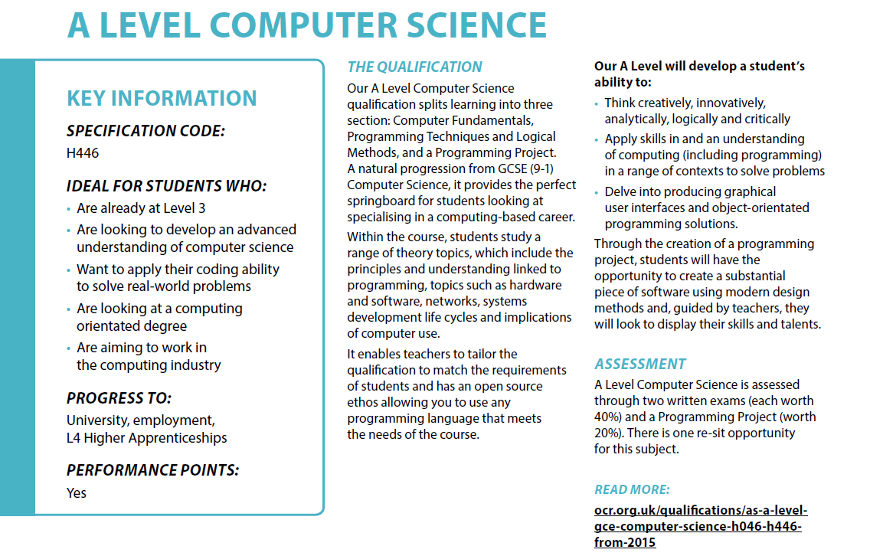

Slide 12
Big Data – Changing our world
Interesting documentary if we have some time left…
https://youtu.be/bIY3LUZ7i8Y

Slide 13
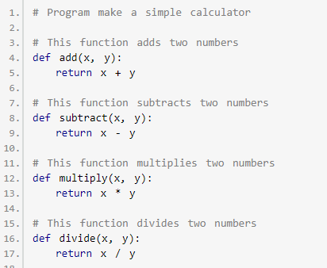
GCSE - Create a text based calculator

Slide 14
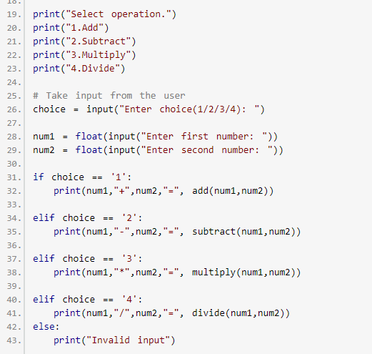
GCSE - Create a text based calculator

Slide 15
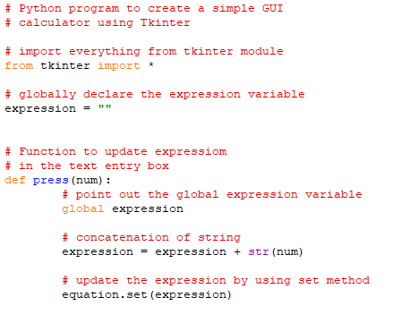
GUI Calculator

Slide 16
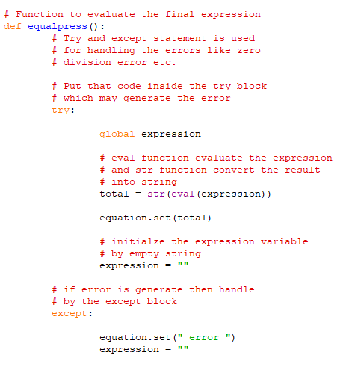
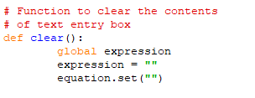
GUI Calculator

Slide 17
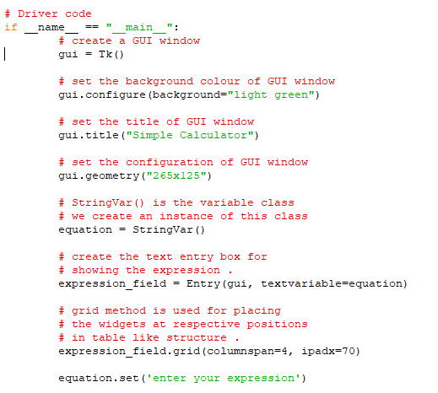
GUI Calculator

Slide 18
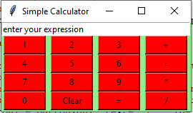
GUI Calculator
Maintain the indent from the previous code
Create the rest of the buttons for the numbers
Ignore the clear and operator buttons

Slide 19
GUI Calculator
Maintain the indent from the previous code
The only difference is a string in the press function call e.g. press(“+”)
Create the rest of the buttons for the operators
Ignore the clear and = buttons

Slide 20
GUI Calculator
Maintain the indent from the previous code
Finish the code with the clear and = buttons and the final gui.mainloop() command

