Slide 1
Level 3 Certificate and Extended Certificate in Applied Business

Slide 2
Introduction to Business
Applied Generals: Key features
https://www.youtube.com/watch?v=JY2n-2xSWik

Slide 3
Applied Generals: What are they?
Level 3 Qualifications within a broad study of a vocational area (unlike Tech-levels)
Can be part of a study programme
Support progression to higher education
Will attract UCAS tariff
Will attract DfE Performance Table points
Have the support of Higher Education
Built to DfE spec – increased rigour

Slide 4
UCAS points
AQA Level 3 Extended Certificate in Applied Business:
Pass 16
Merit 32
Distinction 48
Distinction* 56
For the Certificate, you need to halve these figures.
It should also be said that the 180 will draw down more UCAS points than the new model AS level as this is no longer regarded as a Level 3 qualification.

Slide 5
Certificates in Business
qualification structure
AQA Level 3 Certificate in Applied Business
Learners must achieve all units
 | UNIT TITLE | ASSESSMENT TYPE | OFQUAL UNIT REFERENCE
1 | Financial planning and analysis | External examination | R/507/6695
2 | Business dynamics | Internally centre assessed | Y/507/6696
3 | Entrepreneurial opportunities | External assignment | D/507/6697

Slide 6
The Certificate – ‘developing awareness of enterprise’
Financial planning and analysis
Business dynamics
Entrepreneurial opportunities

Slide 7
Unit 1: Financial planning and analysis
An examined unit (representing 33.33% of the Certificate grade)
Financial issues enterprises need to consider.
Explore ways enterprises can be owned and financed.
Understand the issues that enterprises face concerning cash-flow and be able to calculate profit, break-even and cash-flow.
Use this information along with final accounts and market information to make business decisions.

Slide 8
Unit 2: Business dynamics
A portfolio unit (representing 33.33% of the Certificate grade) Human, physical and financial resources are essential for the success of business organisations.
Investigate factors contributing to the success of businesses, focussing on the role of managers, supervisors and employees.
Consider how businesses organise themselves and will develop the ability to analyse and evaluate the effectiveness of organisational structures.

Slide 9
Unit 3: Entrepreneurial opportunities
A Controlled Assessment Portfolio which is externally marked (representing 33.33% of the Certificate grade)
Develop an understanding of entrepreneurial opportunities and investigate how individuals can exploit these through personal enterprise, e.g. offering a service.
Consider opportunities for their own personal enterprise, a given context and propose marketing and operations activities to take advantage of the entrepreneurial opportunity.

Slide 10
Certificates in Business
qualification structure
AQA Level 3 Extended Certificate in Applied Business
Learners must achieve units 1 – 5 and one unit from units 6, 7 and 8.
 | UNIT TITLE |  | ASSESSMENT TYPE | OFQUAL UNIT REFERENCE
Mandatory
1 | Financial planning and analysis | External examination |  | R/507/6695
2 | Business dynamics | Internally centre assessed |  | Y/507/6696
3 | Entrepreneurial opportunities | External assignment |  | D/507/6697
4 | Managing and leading people | External examination |  | H/507/6698
5 | Developing a business proposal | Internally centre assessed |  | K/507/6699
Optional
6 | e-Business implementation | Internally centre assessed |  | R/507/6700
7 | Managing an event | Internally centre assessed |  | Y/507/6701
8 | Marketing communications | Internally centre assessed |  | D/507/6702

Slide 11
Unit 4: Managing and leading people (Exam)
Explore how organisations operate in a changing environment and use managers and employees to achieve objectives.
Study the importance of leadership, how employees and managers interact in the workplace and the impact of different organisational structures on managers and employees.

Slide 12
Unit 5: Developing a business proposal (Portfolio)
In this portfolio assessed unit
Investigate the processes required to develop, present and evaluate a business proposal.
The business proposal will require human resources beyond those provided by the learner.
Develop a concise proposal and present this to funding providers.

Slide 13
Unit 7: Managing an event (Portfolio)
In this portfolio assessed unit
Investigate the processes required to plan for, co-ordinate and manage a one-off event.
This event will be related to the business proposal.
Review the success of the event and modify their business proposals accordingly.

Slide 14
Certificates in Applied Business
qualification structure
Certificate in Applied Business
Covers fundamental business and entrepreneurial knowledge and skills associated with work in a business enterprise
Synoptic focus: people, markets, finance and operational delivery
Emphasis on not just knowledge and skill development, but on beginning to think and realise own ideas and plans
Unit 3 Entrepreneurial opportunities represents the synoptic culmination of the qualification – where all strands are brought together
Balanced assessment pattern – exam, internal assessment and new external assignment

Slide 15
Certificates in Applied Business
qualification structure
Extended Certificate in Applied Business
Broader and deeper focus of attention on content, e.g. Managing and developing people continues themes from the Certificate
Same synoptic focus on content as the Certificate
Key unit: Business proposal unit – links back to Certificate, integrated links into each of the optional units
Business proposal unit integrated into each of the optional units
Emphasis on broader and deeper ‘applied’ understanding
Each optional unit represents a popular and current area of business

Slide 16
A fully integrated approach
Unit 4
Unit 1
Unit 5
Unit 6
Unit 3
Unit 2
Unit 7
Unit 8

Slide 17
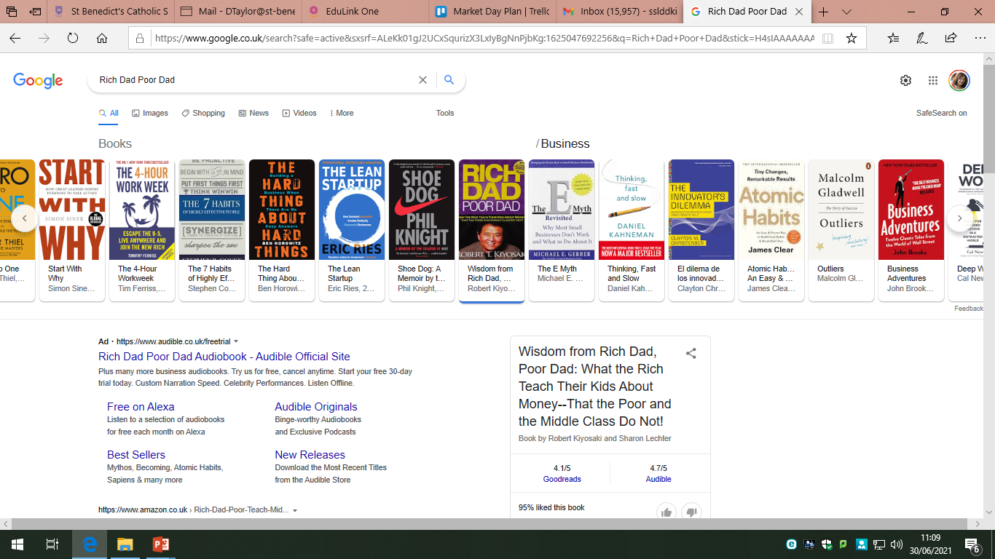
Important Readings
https://www.ted.com/topics/business
https://www.bbc.co.uk/news/business
https://www.cnbc.com/business/
https://www.theguardian.com/uk/business
https://www.ft.com/

Slide 18
Tasks for you to try out
The tasks should give you an idea of some of the topics you will encounter in your course over the next two years. There is a lot more that you will cover.
As a student studying Business you should read and follow news articles related to how companies in all sectors of the economy perform.
Be prepared for more independent learning by being proactive and reading some of the great books on Business.

Slide 19
Myers-Briggs Personality Types and Enterprising Behaviour
PO1: Understanding Enterprising Behaviour
How would you describe your personality?
Think of a famous entrepreneur e.g. Sir Alan Sugar. How would you describe their personality?
Try out this test to see what your own personality type is and how enterprising you may/ not be

Slide 20
Myers-Briggs Personality Types and Enterprising Behaviour
  Myers-Briggs preferences:
    extraversion v introversion
    sensing v intuition
    thinking v feeling
    judging v perceiving
  Myers-Briggs personality types and characteristics
  Own skills levels:
    communication
    research
    team-working
  How Myers-Briggs personality type and own skills affect the ways in which individuals engage in enterprising behaviour

Slide 21
Myers-Briggs Preferences
Myers-Briggs Preferences
  A theory developed by a mother and daughter team based around the work’s of an earlier psychologist Jung
  Identifies 16 personality types categorising the way individuals see the world and make decisions
  Underpinned by 4 principal functions:
    Sensation
    Intuition
    Feeling
    Thinking

Slide 22
Myers-Briggs Preferences
Sensation
Sensation – where does your energy come from? How do you channel your energy?
  Extraversion vs introversion
    Extravert
      Likes dealing in the outside world
      Enjoys having lots of variety in tasks and lots of people
      Motivated by others and motivates others
      Shares ideas and discusses issues to solve problems
    Introvert
      Thinks things through in their head
      Comfortable working on own or with a small group of people known to them
      Reflects on ideas
Read more.
Notes:
http://www.myersbriggs.org/my-mbti-personality-type/mbti-basics/extraversion-or-introversion.htm

Slide 23
Myers-Briggs Preferences
Intuition
Intuition – are you focused more on facts and what you experience from your senses or a feeling of patterns and what might happen
  Sensing vs intuition
    Sensing
      Focused on the now
      Remember facts
      Learn best through experience
      Like to see the practical application of concepts
    Intuition
      Focused on patterns and impressions
      Remember emotions and impressions
      Learn by thinking through concepts
      Happy with abstract concepts
Read more.
Notes:
http://www.myersbriggs.org/my-mbti-personality-type/mbti-basics/sensing-or-intuition.htm

Slide 24
Myers-Briggs Preferences
Feeling
Feeling – do you base decisions on logic or personal involvement? Do you make decisions objectively or subjectively?
  Thinking vs feeling
    Thinking
      Approaches a decision logically e.g. weigh up arguments for and against
      Deal with logic not personal opinions or emotions
    Feeling
      Weigh up the perceived opinions of others involved by the decision
      Concerned for how people feel and like to maintain peace
Read more.
Notes:
http://www.myersbriggs.org/my-mbti-personality-type/mbti-basics/thinking-or-feeling.htm

Slide 25
Myers-Briggs Preferences
Thinking
Thinking– how do you act when with others? How do others perceive you?
  Judging vs perceiving
    Judging
      Decision making preference affects the way an individual is viewed by others
      Like things to be in order and under control
    Perceiving
      Perceiving function preference i.e. sensing vs intuition informs the way you act when with others
      More willing to adapt to changes around you
Read more.
Notes:
http://www.myersbriggs.org/my-mbti-personality-type/mbti-basics/judging-or-perceiving.htm

Slide 26
Myers-Briggs Preferences
For each preference identify your own personality type
Identify where you think the person you are sat with will have placed themselves.
Do you agree with each other?
Extraversion
Introversion
Sensing
Intuition
Thinking
Feeling
Judging
Perceiving

Slide 27
Myer-Gibbs Personality test
https://www.16personalities.com/free-personality-test

Slide 28
From pass to distinction
Demonstrating understanding by using knowledge in context
Breaking problems/issues into parts by using logical chains of argument
Making supported judgements and evaluating their relative importance
+
+
PASS
MERIT
DISTINCTION

Slide 29
Motivational Theories
When you study the unit relating to Managing and Leading people, you will encounter motivational theories, such as:
Maslow's hierarchy of needs. Abraham Maslow postulated that a person will be motivated when his needs are fulfilled. ...
Hertzberg's two factor theory. ...
McClelland's theory of needs. ...
Vroom's theory of expectancy. ...
McGregor's theory X and theory Y.
Try to find out about these theories and watch the videos on McGregor's X & Y Theory
http://www.youtube.com/watch?v=Mvrg5m-SfPs
https://www.youtube.com/watch?v=NK8-LhqF4N0

Slide 30
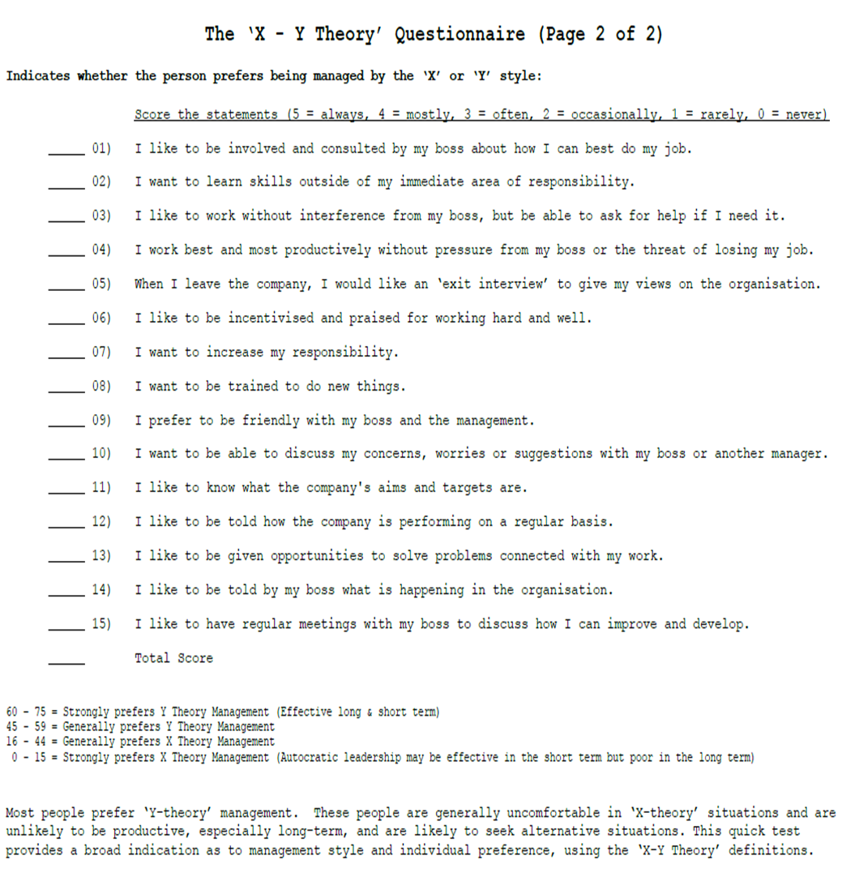

Slide 31
The Apprentice - Comics
Everything can have a light side to it the TV series, ‘The Apprentice’ presents one of these.
There may even be some truths or reality in such dramatized versions of what happens in the world of work and business.
Watch this episode and see if you can identify any aspects which might be true to reality.
Which aspects, do you think, are purely dramatic just for the entertainment value?
https://www.bbc.co.uk/iplayer/episode/b086yl47/the-apprentice-series-12-14-the-final

Slide 32
Business Game Activity
http://www.thesmallbusinessgame.co.uk
Try it out for yourself!

