Slide 1
Reading Revision of grammar is a good idea. Audible (online app) has a small selection of Spanish novels and short stories.
Research We will be studying the film “Volver“ by Pedro Almodóvar
in Year 12. If you can buy it now, that is a good idea. It would be useful for you to watch it now (although we will also do it in class) .
In Year 13 we will be studying the play “La Casa de Bernarda Alba” by Federico García Lorca
Doing some research into these two cultural topics would be a good idea.
Research into one or more of the topics we will study in year 12 would also be useful. See below for some questions you could begin to answer.
Look on the AQA website under A level Spanish. This should give you an idea of the topics you could be researching.

Slide 2

In Year 12 you will also be studying the film “Volver” directed by Pedro Almodóvar
We will be watching this film in class but if you can get hold of a copy, it is useful for you to watch it now.
TASK 1: Research the film director Pedro Almodóvar and write ten sentences in Spanish about him. Make sure that you understand all the information you are writing and avoid any indiscriminate copying and pasting.
TASK 2: Access the wikipedia in Spanish about the film “Volver”
Try to translate the first two paragraphs of the “argumento” (=plot) section.
You can, of course, have a go at translating the whole text but it is a good idea to do this in smaller chunks as this is quite a challenging (but also fun!!) language task.
Please feel free to ask for help if you get stuck and send us your translations. We would love to see your work.
Note down any new vocabulary. Get yourself an exercise book or start your own vocab log on your computer/mobile and keep adding to it as you progress with your research/studies. Your vocab log is something that should be constantly evolving! Don’t forget to go over your words regularly. You will be surprised what a difference this will soon make to your Spanish.

Slide 3
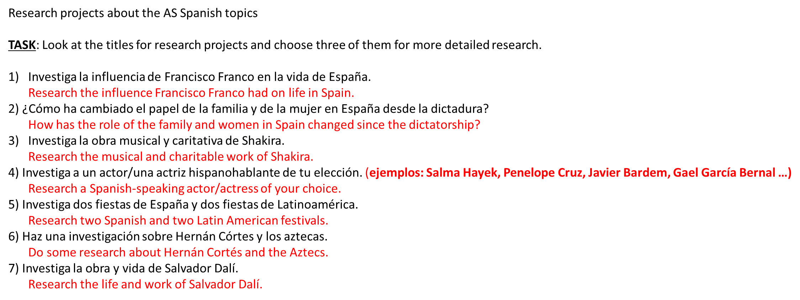

Slide 4
Reflection
Teach vid is a good website for listening to and practicing language. They have a reasonable selection of free activities.
Listen to Spanish music on Youtube. Listen, then try to work out the lyrics/ topic of the song. Keep a record of what you have listened to and write a review.
Spanish news websites
https://www.bbc.com/mundo
https://www.20minutos.es/
https://www.antena3.com/noticias/
TASK 1: translate 10 news headlines from different websites.
TASK 2: choose one article , look up the words you don’t know and then write a summary of the main ideas.

Slide 5
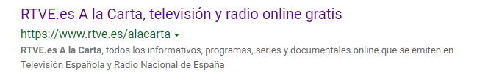

Watching Spanish television
https://www.rtve.es/alacarta/
News, programmes, series and online documentaries which are broadcast on Spanish television and radio.

Slide 6
Spanish grammar websites
https://studyspanish.com/grammar
Excellent grammar website with detailed explanations on a great variety of grammar topics and quizzes to test your knowledge.
Plenty of verb drills in all relevant tenses.
www.languagesonline.org.uk
Vocabulary, grammar, AS resources, A2 resources
http://www.bowdoin.edu/~eyepes/newgr/ats/index.html
Online grammar book with exercises and solutions
You can practise the grammar on these websites.
It is a good idea to tackle grammar topics one by one, read through the explanations, then do the tasks/quizzes.
Doing grammar little and often really helps embed it in your brain.

