Slide 1
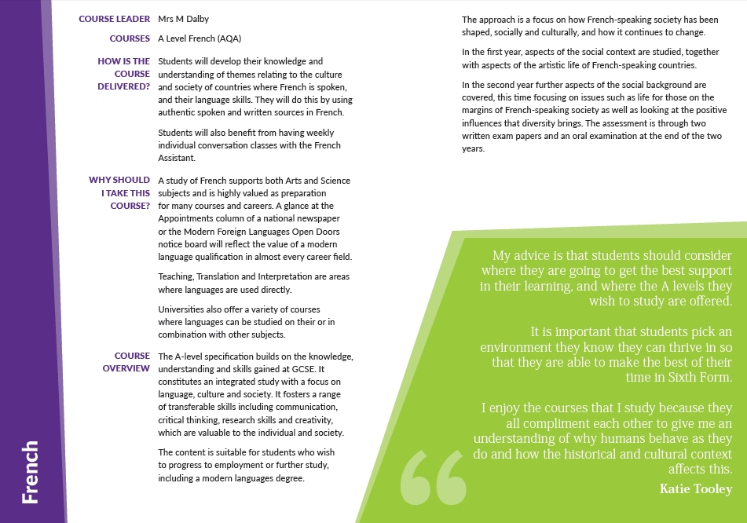


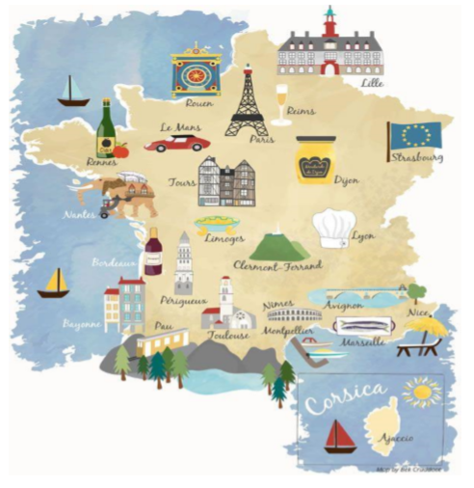




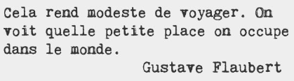

Bienvenue au département de français pour A Level

Slide 2


Bienvenue au département de français pour A Level
Welcome to the A Level French department at St Benedict’s Sixth Form.
As you are aware, a foreign language needs
to be maintained on a regular basis otherwise
recall for vocabulary and grammar becomes
a little tricky.
Therefore, we recommend that you take some
time before starting the course in September
to complete the work on these pages and
explore some of the links we have
selected for you.

Slide 3
Bienvenue au département de français pour A Level
Fortunately, you have some time in which to prepare for your French A Level. The leap from GCSE to A Level is significant but is entirely achievable. The following links, most of which are available online and for free, will hold you in good stead for starting off and continuing on the right path. Lisez! Écoutez! Regardez! Régalez-vous!
www.tv5monde.com Online television network broadcasting French-language programming from all sectors.
www.euronews.net Online news site where you select French from the languages they have on offer. You can watch the news clips with the transcript below. You can also go directly to http://fr.euronews.com/ and watch news clips in French and then watch it in English to see how much you have understood.
www.lemonade.fr Online version of a national French newspaper.
www.liberation.fr Online version of a national French newspaper.
www.l-eco.fr is a website for young people incorporating sections on mobile technology, science & wildlife, education, culture, sport and society.
www.radiofrance.fr offers different networks focusing on different programming, a little similar to how BBC radio works.
www.lesinrocks.com online version of the cultural magazine focusing primarily on music, film, television, art and theatre.
You could also switch to French browsers such as www.google.fr or http://fr.yahoo.com/ requiring you to read French every time you log on therefore becoming part of your everyday activity. Don’t forget that streaming services have many French TV shows and films.

Slide 4
Bienvenue au département de français pour A Level
There is plenty of grammar practice exercises you can find online.
www.languagesonline.org.uk allows you to select what grammar you want to revise. You can practice as often as possible. A good tactic is to translate the examples and exercises into English to ensure you understand the meaning of each tense.
http://conjuguemos.com/ is very good for practicing your verb conjugations.
www.tex’sfrenchgrammar.org has plenty to choose from and is favourite of Mrs Dalby!
https://www.zut.org.uk/advanced/year12.html is available for free from 4pm. Great to practice verbs, pronouns, translations and review other grammar points.
Reference books are useful to have too. We suggest the following –
‘Mot à Mot’ by Paul Humberstone. The vocab is divided up into topic areas.
‘Bescherelle Complete Guide to Conjugating 12,000 French verbs (English version) is very useful when writing essays.
Elan Grammar Workbook by Gill Maynard and Marian Jones
It is important to have access to a proper dictionary such as Collins, however if you are to use to your phone www.linguee.fr is great as a dictionary but also gives you words in different contexts.

Slide 5

Bienvenue au département de français pour A Level
You will notice early on in your French A Level that you are almost completing a Sociology course in French. You will be learning all about the history and culture of French societies from across the globe. Please take a look at the following websites when starting your research on any topic –
www.gouvernement.fr a French government run website.
www.institute-francais.org.uk promotes French culture in the UK and cross-cultural exchange. Language courses, film screenings, talks, concerts are sometimes offered.
http://French.about.com/ is an English website but has good links.
http://schoolonline.britishcouncil.org/ has plenty of information for students.
www.fr.wikipedia (but remember to validate your research as anyone can write information. Please do note quote from Wikipedia).

Slide 6
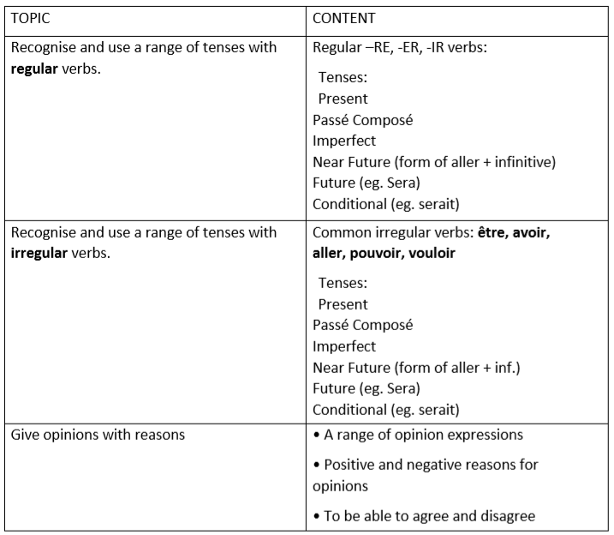
Bienvenue au département de français pour A Level
What should I know by now? A common question asked by students embarking on their French A Level. Check that you are familiar and confident with the following –

Slide 7
Bienvenue au département de français pour A Level
Work to complete over the summer –
Choose one of the following to bring in with you in September:
A piece of French writing (200 words) that uses as many of the tenses found on slide 4 explaining all about you, where you have been, what you have done, what you are up now and what you would like to do in the future. You can include photos and present it as a visual display.
A piece of original storytelling in French (200 words). This could be in the shape of a short story, graphic novel (for any of you who enjoy art too!), prose poem, etc.
Watch a French film and prepare a 3-5min oral presentation in French with accompanying PowerPoint explaining the premise of the movie, your opinions & reasons and background information about the writer/director and main actors.
Read a short work of French fiction and do the same as for the French film.

Slide 8
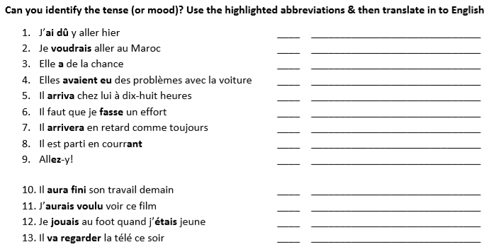
Bienvenue au département de français pour A Level
Work to complete over the summer –

Slide 9
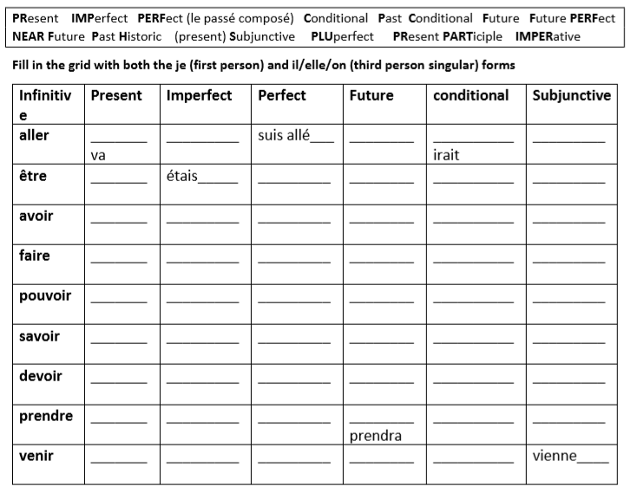
Bienvenue au département de français pour A Level
Work to complete over the summer –

