Slide 1


Year 10 Parents’
Curriculum Evening
8th October 2024
Community and Preparation

Slide 2
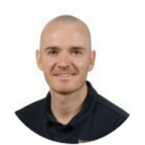
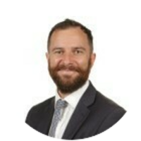
This evening’s schedule
Welcome and prayer
Overview of the year ahead, my vision, attendance, behaviour and expectations (Mr Turner Head of Year 10)
Additional Information:
Guide to GCSE assessment
Revision – relearn, retrieve, rehearse
Students working at home
GCSE POD and One note
Where to find curriculum information
Teen brain and Mental Health
Mr Turner
(Senior Progress Leader- Year 10)
Mr Tatum
(Deputy Headteacher- SLT line manager for Year 10)

Slide 3
Pause for reflection
Lord,
You are the light that guides my feet.
You are the map that gives me direction.
You are the peace that makes me strong.
You are the leader whom I faithfully follow.
May your light illuminate my life
And your guidance bring direction.
May I find inspiration in your word
And peace in my heart as I follow you.
Amen.

Slide 4
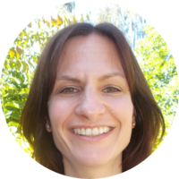
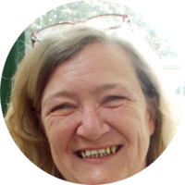
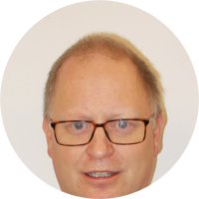
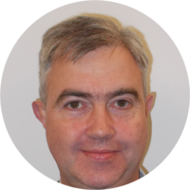
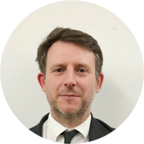
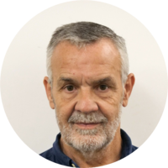
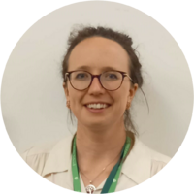
Tutor team –
@st-benedicts.suffolk.sch.uk
10A Jwintersteller @ or Kreeman@
1oC Nstiff@
1oL Dwallace @
10P Jsayer@
1os Dsankey@
10X Ddunsmore @

Slide 5

Key dates for Year 10
Information evening 8th October
Attitude to learning drop Half-term 1 – 18th October 2024
ATL and Attainment Half-Term 2- 18TH December 2024
ATL HT3 – 7th February 2025
Tutor reports – 3rd March 2025
Year 10 Parents evening 6th March 2024
ATL half term 4
SPL/tutor invite on parents meetings W/C 22ND April
ATL Half term 5 16th May 2025
Year 10 Mock Exams W/C 16TH June to 27th June 2 weeks

Slide 6
Support in school
Tutor
Pastoral office
Pastoral support
Classroom teachers
School nurse drop ins
School chaplain

Slide 7
My vision for Year 10
Politeness and respect to staff and students-Manners cost nothing
How you present yourself- Uniform, first impressions count
Raise money for charity and give back to the school community
Work Hard and graft: Improve attitude to learning, ask teachers what can we do to get better

Slide 8
What I want Year 10 to be known for…..
I want this year group to known as a year group that everyone loves to teach.
If students follow expectations and the visons I have set them, I know you will be ready and prepared for KS4 and be successful when picking up your results in two years time.
I want students to leave school confident and ready to flourish on the next stages of their education. The hard work starts now, Year 10 is where we should be pushing ourselves to be the best we can be.
If I can implement these visions to you then I will be proud that I have influenced, you to be the people you are today and to give you choices when leaving secondary education.

Slide 9
The importance of Attendance
How attendance affects your chances of success at GCSE
Notes:
You will see from the graph how drastically attendance affects attainment.
90% attendance is 1 day off per fortnight.
1 day lost per fortnight = 4 weeks of school over the year
4 lost weeks of school = 100 lessons
Over 5 years of schooling 90% attendance = ½ a YEAR of education lost .

Slide 10
Attendance
“One day off a fortnight…that’s not too bad?”
1 day lost per fortnight = 4 weeks of school over the year
4 lost weeks of school = 120 lessons
Over 5 years of schooling 90% attendance = ½ a YEAR of education lost
Less than 50% chance of achieving the government benchmark of 5+ 9-4 Grades

Slide 11
Punctuality
Lateness = Lost Learning*(Figures below are calculated over a school year)
5 minutes late each day | 3 days lost!
10 minutes late each day | 6.5 days lost!
15 minutes late each day | 10 days lost!
20 minutes late each day | 13 days lost!
30 minutes late each day | 19 days lost!
These students will drop AT LEAST ONE GCSE GRADE

Slide 12
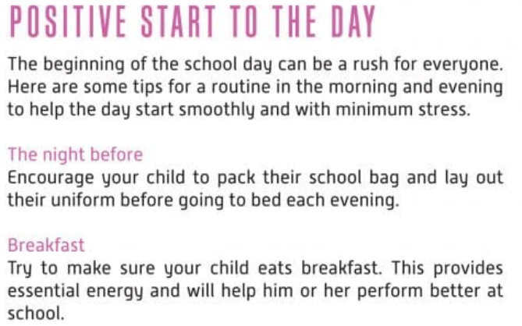
Organisation

Slide 13
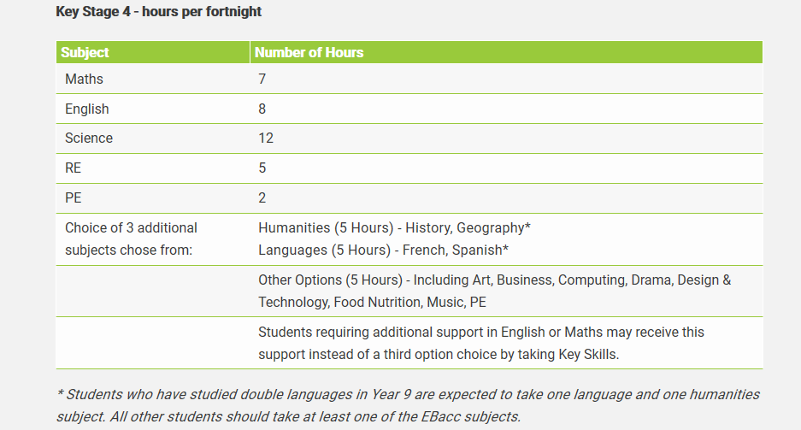
Curriculum Allocation

Slide 14
A knowledge based curriculum
There is generally more content to learn in the new 9-1 GCSE
There is virtually no internal assessment
There are generally more examination hours in the new 9-1 GCSE
In short there is a need to build up a continuous body of knowledge and be able to apply this knowledge.

Slide 15
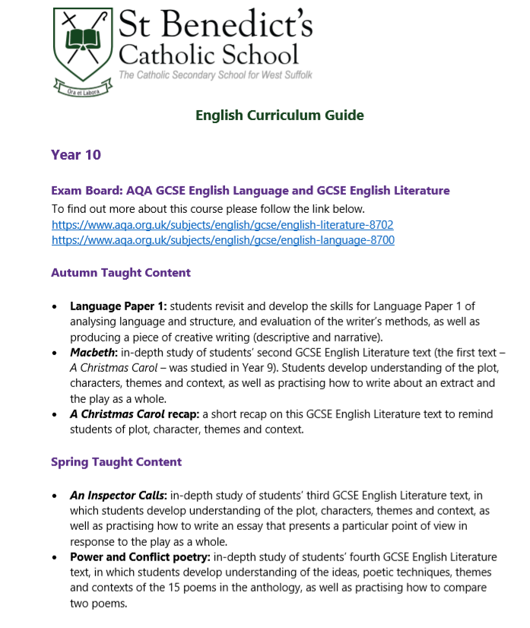
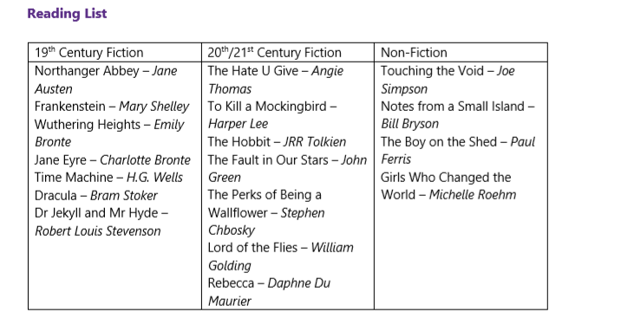
Curriculum Information
Revision information can be found on our school website- Select Curriculum and find the Year 10 Revision guide.

Slide 16


GCSE Grading
The key grade is a level 4 this opens doors to future endeavours.
But……..
Does the support at home really make a difference?

Slide 17
Attainment reporting in Year 10
Two assessments for attainment reported end of term 1 an end of term 3.
Each assessment point will assess both current material and previous work.
Encourage students to prepare for these assessments – helps to build this body of knowledge.
We use low stakes little and often testing in class to ensure information is constantly revisited.

Slide 18
Attitude to learning reporting in Year 10
Early attitude to learning report to give you a prompt indication of how pupils are settling into the new academic year.
Attitude to learning will be reported via a new simplified Effort Grade which will be awarded on a 1 to 3 scale, based on our school values of Compassion, Wisdom and Resilience.
1 = below expected attitude to learning – intervention expected
2 = meets expected attitude to learning
3 = Exceeds expected attitude to learning

Slide 19
Extra Curricular
Expectation of students enrolling in at least one club.
Extra curricular timetable to be released in the second full week of term.
Everyone is expected to attend at least 1 club per week
Sports, Drama, Music, Art, School Newspaper, Literary clubs, Chess, Manga drawing, gardening, kite flying, Japanese culture etc.
St Benedict’s award continues

Slide 20

Students working outside the classroom
Students who reported in Year 9 spending between 2 and 3 hours on homework on an average weeknight were almost 10 times more likely to achieve 5 A*-C than students who did not spend any time on homework.
Just how effective is independent home study………
These results show independent study and effort by students are very important contributors to academic success at GCSE, over and above all other background influences and prior attainment.

Slide 21
How can parents support their child working outside the classroom …
Create a safe place to work at home. Desk/area where you can monitor their work.
Set them a time each evening with no distractions. We recommend 1 hour 30 minutes per night.
This can be split into small sessions of 20-30 minutes allocated to different subjects.
Help create a revision timetable- I will be sending around a template to all students on Arbor.

Slide 22
Microsoft OneNote
All students have Microsoft 365 accounts at St Benedict’s.
They can use Word, PowerPoint, Excel and other Microsoft services at school or home, logging in using their school e-mail address and their usual password.
One service that we want students to use from home is Microsoft OneNote.

Slide 23
OneNote
Using OneNote, students can access a class notebook for each of their subjects.
Class Notebooks allow teachers to share each lesson with students so they can revise properly for assessments or reflect back on lessons when completing homework.
To access a class notebook students first log into their Microsoft account on the Microsoft Teams service.

Slide 24
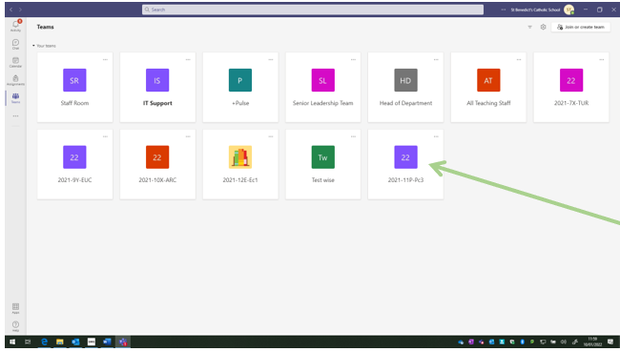
Access
Search Microsoft Teams.
Follow the link.
Sign in using St Benedict’s email address and password.
Select the team for the subject you wish to access.

Slide 25
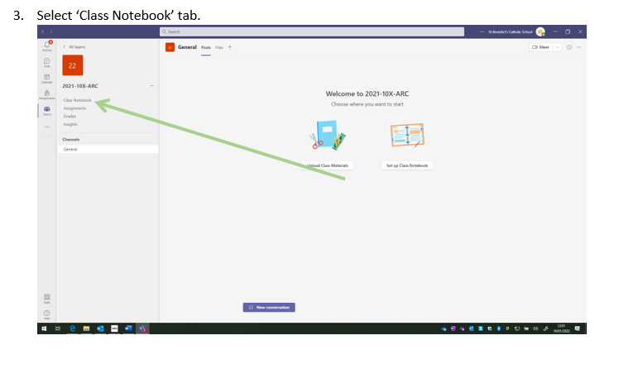
How can it be accessed?

Slide 26
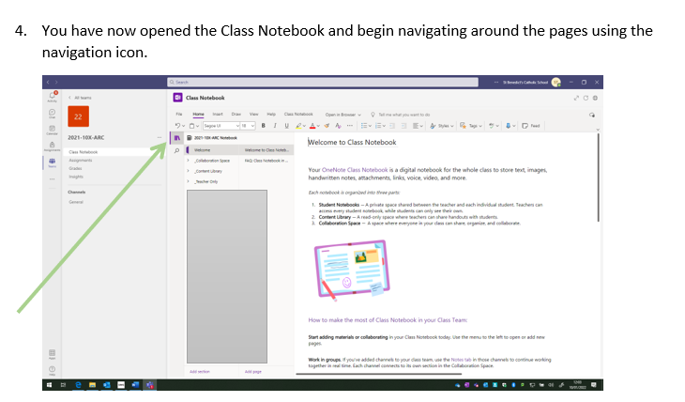
How can it be accessed?

Slide 27
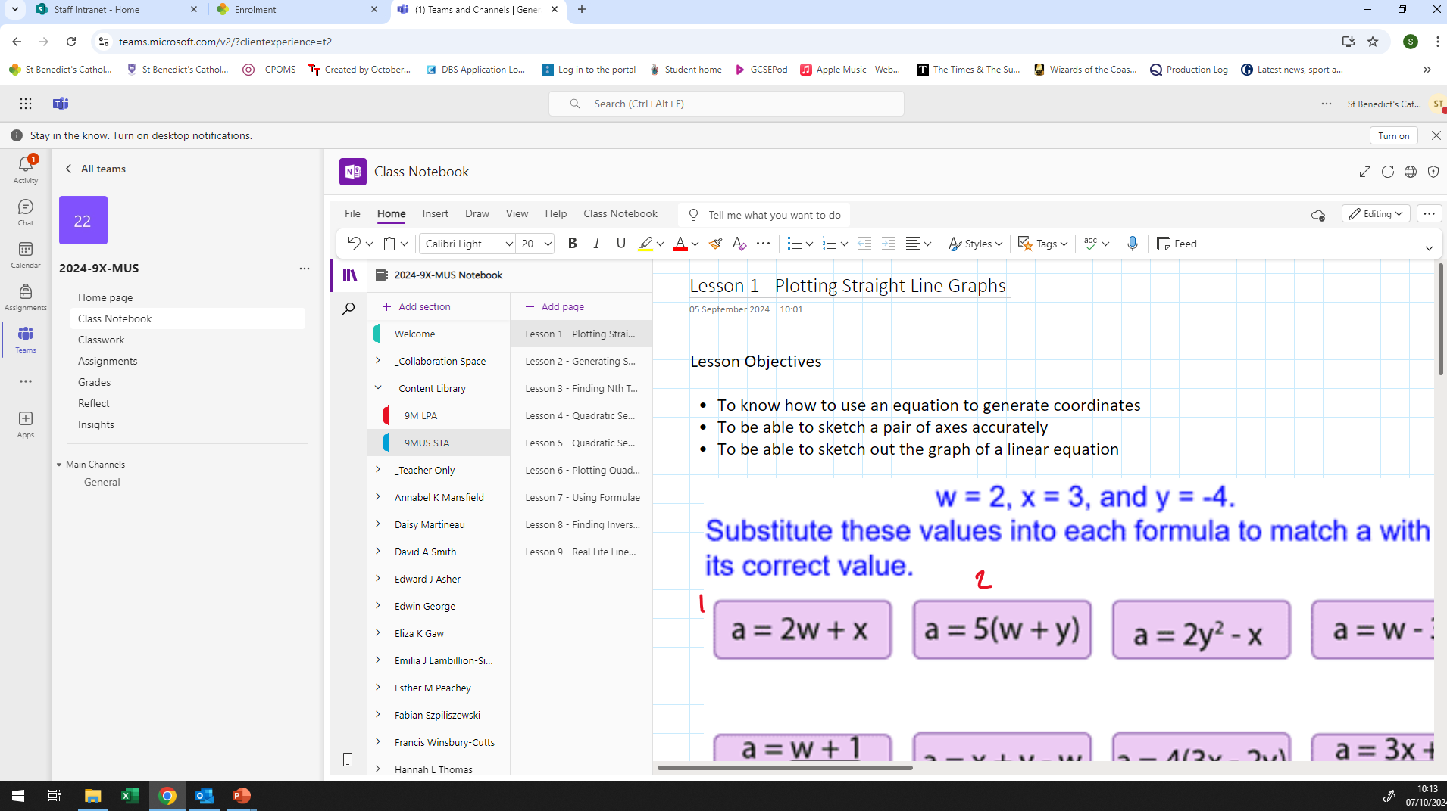
Class Notebooks

Slide 28
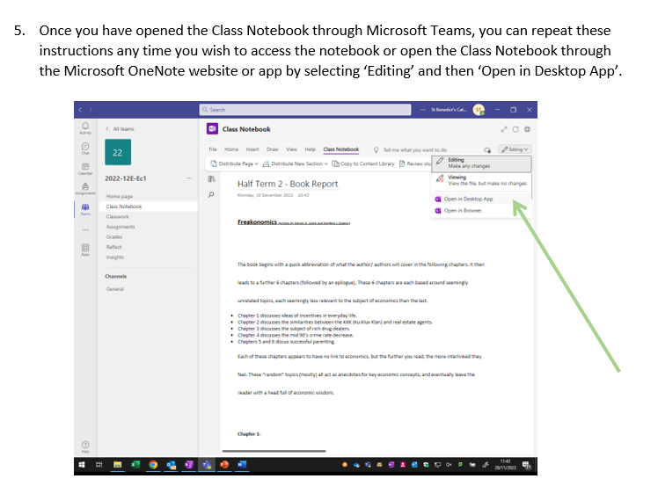
How can it be accessed?

Slide 29
GCSE Pod Login Instructions

Slide 30
GCSE Pod
One website, accessible anywhere and everywhere
Over 7,500+ Pods Content produced specifically for mobile devices, tablets & PC’s
Designed to squeeze exactly the right knowledge needed for exam success into short 3–5minute chunks
Helps with learning, homework & revision.

Slide 31

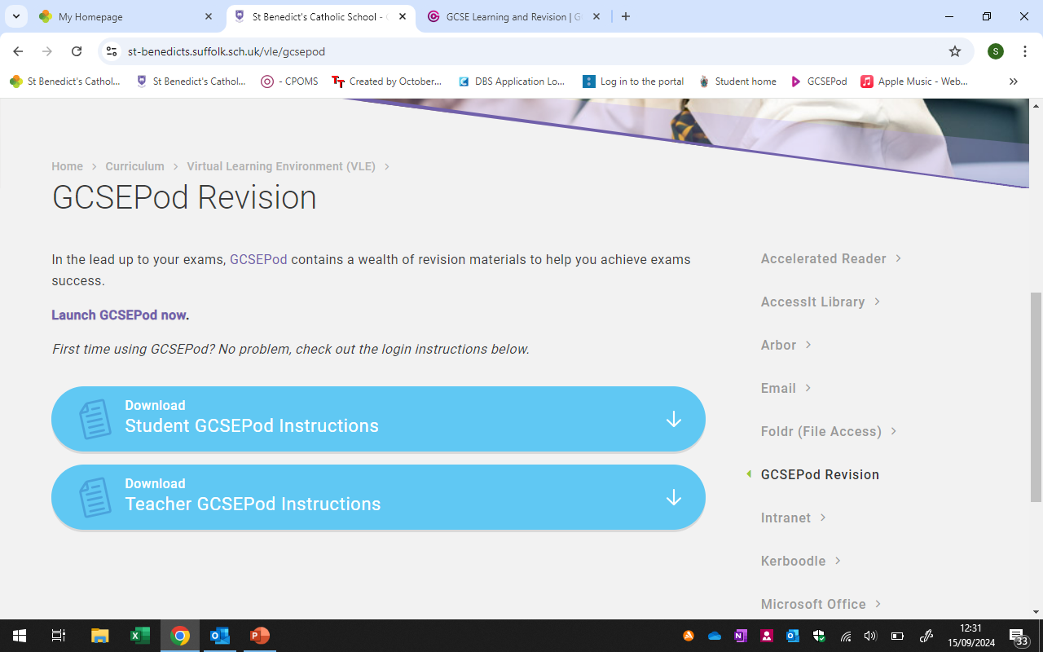
Using for the first time
Search GCSE Pod on any search engine and select login in the top right corner
Alternatively, go to the school website. Select the curriculum drop down, then VLE, the GCSE Pod.
Then click ‘launch GCSE Pod now’

Slide 32
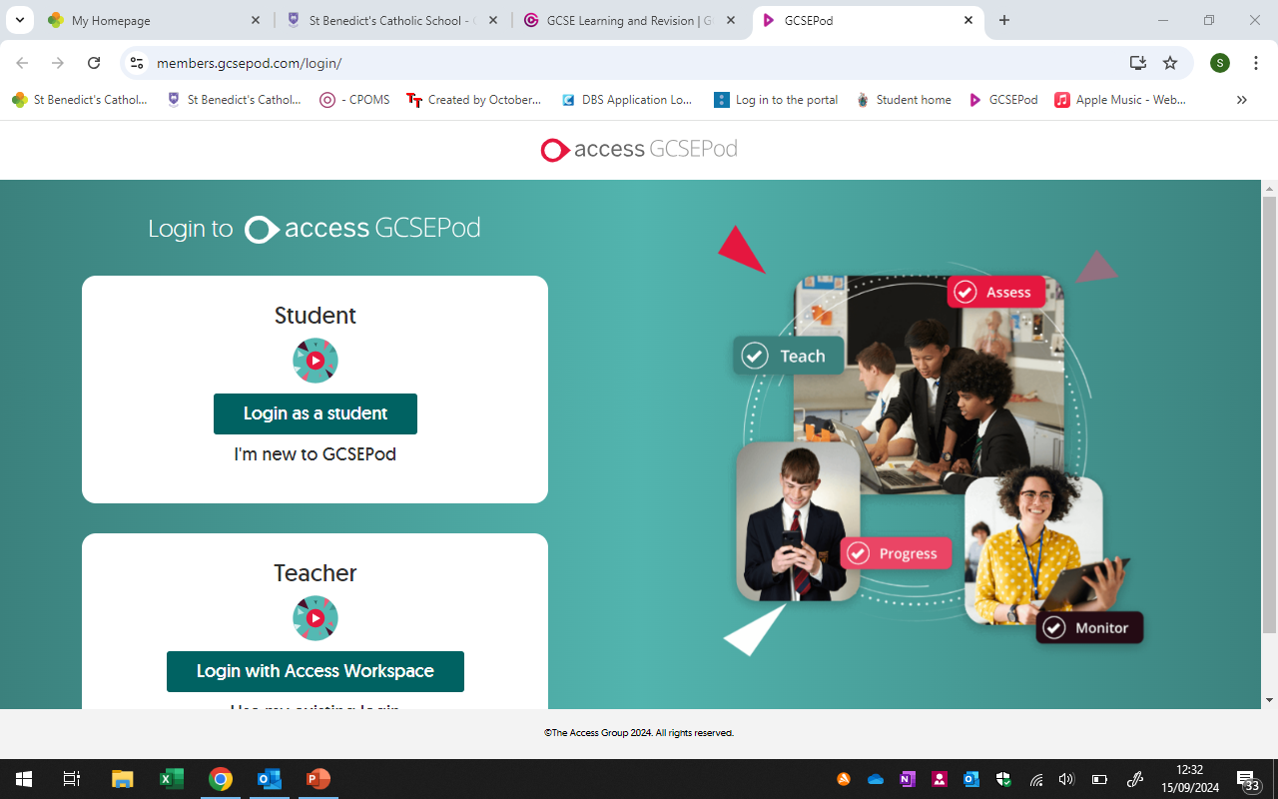
Log In Screen
The next screen you will see will give you the option to login as a student if you know your login details.
If you don’t, just select ‘I’m new to GCSEPod’.

Slide 33
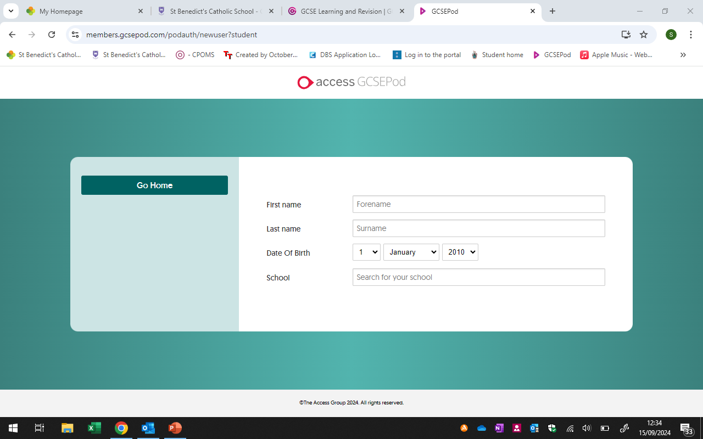
Add your information
You will be asked for your first and last name, your date of birth and then to search for our school, St Benedict’s.
Enter all the information and

Slide 34
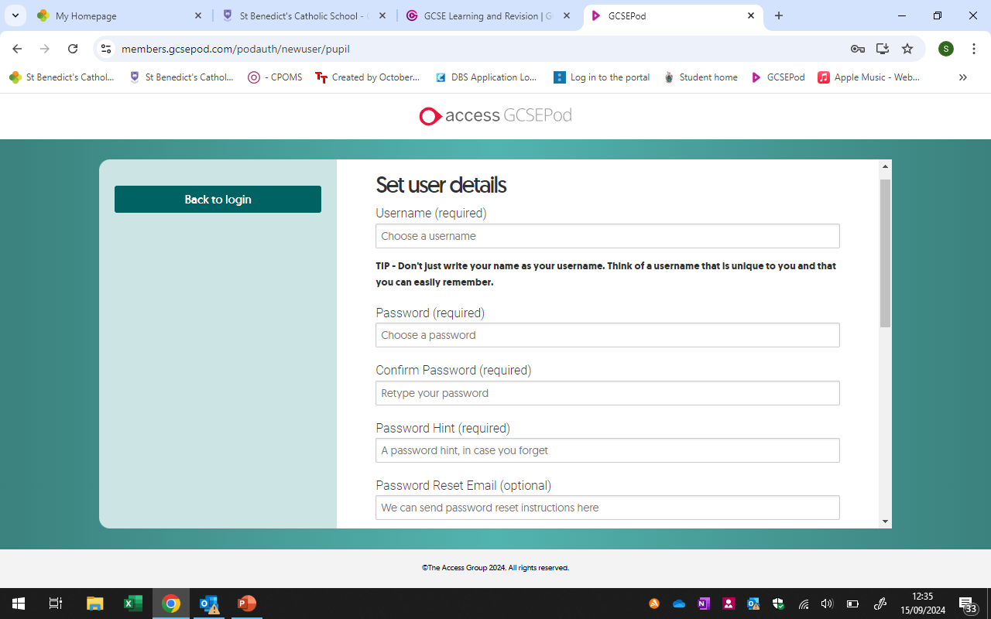
The next screen will ask you to create a password, a hint and a recovery e-mail.
Enter your created password and your school e-mail address.
You can then select the subjects you are studying in school.

Slide 35
Revision:
What the research says works
Only two of the 10 techniques examined turned out to be really effective - testing yourself and spreading out your revision over time
Elaborative interrogation - being able to explain a point or fact - MODERATE
Self-explanation - how a problem was solved - MODERATE
Summarising - writing summaries of texts - LOW
Highlighting/underlining - LOW
Keyword mnemonics - choosing a word to associate with information - LOW
Imagery - forming mental pictures while reading or listening - LOW
Re-reading - LOW
Practice testing - Self-testing to check knowledge - especially using flash cards - HIGH
Distributed practice - spreading out study over time - HIGH
Interleaved practice - switching between different kinds of problems - MODERATE

Slide 36

BUT!
Any revision is better than no revision and whilst two hours of focused revision alone is more effective than three hours revising with friends, both are more effective than half an hour reading the textbook before getting distracted.

Slide 37

There are many ways we can help strengthening positive brain connections:
  Let children take some healthy risks – explorative learning and allowing mistakes, get them to take the risk of trying.
  Promote new creative and expressive outlets
  Talk through decisions
  Routine and timetables
  Provide boundaries - school is the safe place to negotiate boundaries and this is a vital and healthy part of brain development
  Offer frequent praise and positive rewards for desired behaviour. This reinforces pathways in your child’s brain.
  Be a positive role model. Your behaviour will show your child the behaviour you expect.
  Stay connected Be open and approachable
  Talk – not just at a child but to the child, showing listening and consideration
Remember their neural pathways are developing and we can be fundamental in nurturing this development, even if we do not see the end result.

Slide 38
Mental Health
The incidence of poor mental health increases during the teenage years. It’s thought this could be related to the fact that the developing brain is more vulnerable to stress factors than the adult brain.
Anxiety and depression in children has risen by 48% since 2004.
Talking and listening can build mental wellness

Slide 39
Mental Health
Experts say it can be easier to talk if you’re doing something else.
Talking whilst Sharing a Meal.
Spending Quality Time together and Talk.
Finding Space to Talk.
Take 5 Minutes To Share.
Talking whilst Cooking Together.
Being There To Help – Just ask “How was your day?”
REMEMBER You are Not Alone - reach out we are all in this together, just be honest.

Slide 40

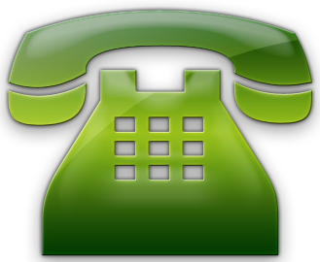
Thank you!
Without your support, the task would be
far harder.
We will endeavour to work together and aim for the highest possible outcomes for our students!
Please keep in touch.

