Slide 1



Year 8
2025/26
Parent information Evening
Ms Wray vwray@st-benedicts.suffolk.sch.uk

Slide 2
Pause for reflection
Lord,
You are the light that guides my feet.
You are the map that gives me direction.
You are the peace that makes me strong.
You are the leader whom I faithfully follow.
May your light illuminate my life
And your guidance bring direction.
May I find inspiration in your word
And peace in my heart as I follow you.
St. Benedict … pray for us.
Amen.

Slide 3
The theme for this year:
The little things matter.

Slide 4
Same rules apply…
Punctuality - both to school and to lessons
Correct equipment to all lessons
Correct uniform – Also worn correctly
No phones
Classroom behaviour code Three step sanction system – warning, behaviour point, remove
We operate daily lunch detentions in E3 with the Heads of Year. 20 minutes for uniform issues, 40 minutes for removal from class.
We operate twice weekly after school detentions, Wednesday for 60 minutes with Teaching staff, and Friday for either 60/90 minutes with SLT. Both start 3:45 and either go to 4:45 or 5:15pm.
Homework neat and on time - Arbor
Notes:
Three step sanction system. Warning, move, remove. If the student is removed they spend the rest of that lesson in isolation. If this happens again during the day = remain in isolation.
Removal from lesson = an email will be sent home to inform you that ASD will take place the next day.

Slide 5
Uniform
We have not changed our expectations around uniform from last year.
The behaviour system contains a Uniform Code behaviour point
The key thing for us all to work towards is to make sure the high standards they have now continue. We really appreciate your help in ensuring our school uniform is worn properly.
If there is a problem, just please make sure to communicate with us. An email to tutor, or a hand-written note, and the tutor can issue a green card first thing in the morning. Where issues come in it tends to be when things are left.

Slide 6
Attitude to Learning (ATL) in Year 8
We have a system of attitude to learning grades (ATL)
You will receive a report from us at the end of each half term with an ATL grade for each subject.
They are intended to give you an idea of your child's pattern of attitude and effort in the subject.
These grades are from a 1 to a 3. A grade 2 indicates expected and acceptable attitude to learning. A 3 indicates outstanding attitude, and a grade 1 indicates unacceptable attitude to learning.
The intention of these reports is to start conversation with your children, to celebrate what is going well and how you can support what isn’t.

Slide 7
Arbor
We are continuing our pupil management system of Arbor. Hopefully you’ve all used to it by now.
Arbor will automatically send emails to parents to advise of incidents – these may not result in a behaviour mark, but are important for parents to be aware
All homework will be set on Arbor, but usually isn’t handed in there.

Slide 8
One Note
One note is a IT system used to support classwork. Teachers will create class notebooks, and upload class material to there.
They may ask students to submit work via one note.
The log in details are exactly the same as the details needed to log onto the school’s system.
If your young person is absent from lessons, there will be work there to enable them to catch up.
To support their learning at home, it would be really good if you can support them in getting onto this platform, and help them in learning to use it.

Slide 9
A knowledge based curriculum
There is generally one assessment each term in each subject.
There are three assessment points in the year, one at the end of each term. These will be the ones communicated directly to you on reports.
Some practical subjects will use project based assignments.
The formal assessments are just one piece of evidence used to assign current working grades.
Expect the content requirements of Year 8 to be higher and more demanding than Year 7.

Slide 10
Assessment
Ks3 Grading System
8M | Mastered | Demonstrated a comprehensive understanding of all concepts and skills in a unit of work.
8E | Extended | Grasped the main concepts and skills in a unit of work and can apply to new contexts.
8S | Secure | Has a secure understanding of the main concepts and skills when applied to familiar contexts.
8A | Approaching | Grasped most of the main concepts and skills in a unit of work and is approaching ‘secure’.
8D | Developing | Grasped some of the main ideas and skills in a unit of work but others require development.
8B | Beginning | Beginning to grasp some of the main ideas and skills in a unit of work.

Slide 11
Clubs
The extra-curricular timetable is available on Arbor, and you can sign your child up to the club there. Doing that will make the club appear on their timetable, and also add them to the teacher's register.
They are of course welcome to head along and try out a club before signing up for it, we just ask that once they decide to start going regularly you sign them up on Arbor.
We have made a real effort to get a good range of clubs available to the students. Our expectation is that every student is undertaking at least one extra-curricular activity regularly.
We really appreciate your support with this

Slide 12
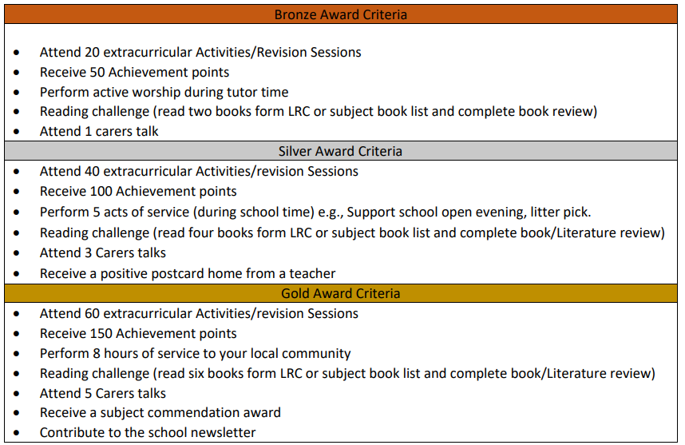
St Benedict's Award

Slide 13



This year is all about competition
There are some changes from last year!

Slide 14
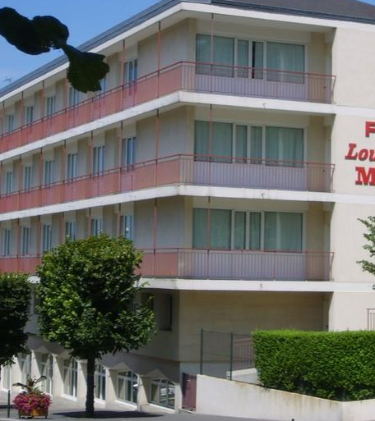
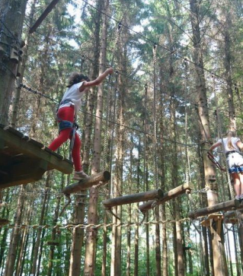
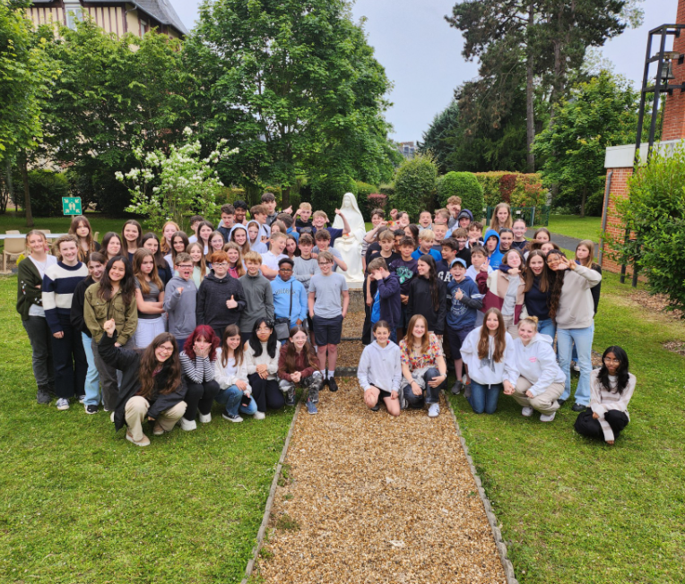
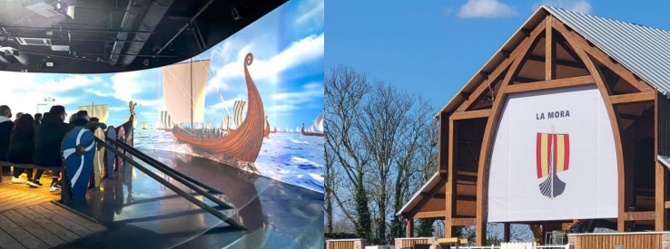
Year 8 French Residential 2026
Monday 15th to Friday 19th June 2026

Slide 15
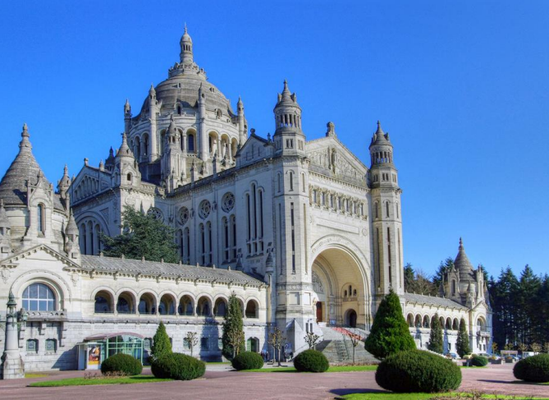
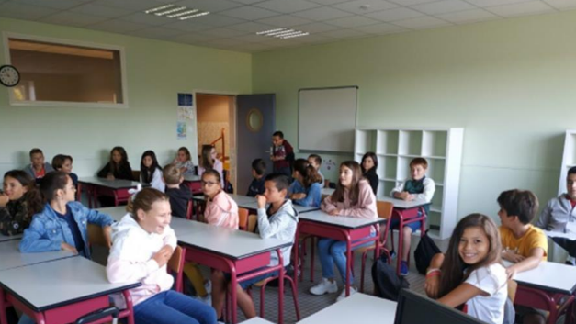
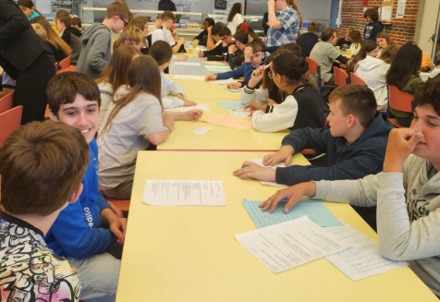
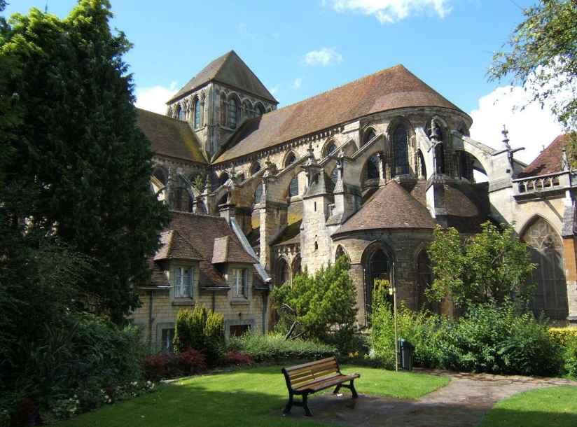
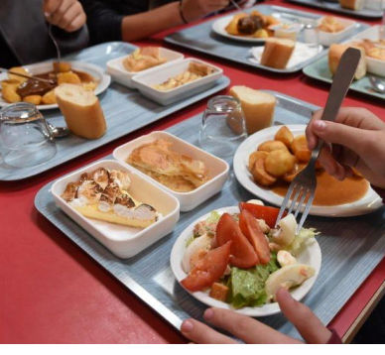

The trip includes
Bus travel throughout the trip.
Accommodation at Foyer Martin in central Lisieux (room range between 1 to 5)
French school experience with a school Pierre Simon De Laplace
Day visit to Honfluer and La Mora (interactive Museum of William the Conqueror).
Tour of Basilica Saint Therese de Lisieux.
Visit to a cheese Factory with tasting
Activity centre Beauregard Adventure for high ropes.
Mass in Cathedrale Saint-Pierre in central Lisieux
Three meals a day, Breakfast, packed lunch and hot dinner.
Price is approx. £545 for 70 students attending, price does drop every 10 places.

Slide 16
Social Media
Year 8 is often the time when social media usage starts to become highly problematic.
What we find is that social issues are often hugely magnified by social media, and often minor issues outside of school can become much larger.
A lot of this is caused by our young people still not being ready to communicate unsupported or supervised on these sorts of platforms.
The pupils still do not meet the age requirements on the platforms for use of most social media types.
If you have made the decision as a parent to allow your child to use these platforms, I really want to encourage you to offer them support and guidance on how to use them in a healthy way, rather than just leaving them to it.

Slide 17
Social Media Use
Make sure you are aware of the different types of Social media your child has, and what they are using them for. Have oversight of passwords and accounts.
At times, go through their social media with them, to make sure you are happy with the content they are accessing and posting. Have a look at group chat conversations. Do this regularly, and not just when something goes really wrong.
Give your child a time limit on their devices, and take them in at the end of the day. Unrestricted access, particularly late at night can be very unhealthy.
Establish a line of communication with your child, where they feel comfortable coming and talking to you about their social media. If they feel your interested and engaged with that part of their life, chances are they will come to you when they need help. If they feel its something they are always in trouble for, they won’t reach out when they do need help.

Slide 18
Teenagers…
For most of your children, year 8 will see the beginning of the teenage years
A child’s thinking and behaviour can seem quite mature, but at other times illogical, impulsive or emotional.
Teenagers are often passionate about their interests, especially ones that give them opportunities to socialise.
Every teenage child is unique, and teenagers respond in different and unique ways.
Even though your child will be beginning to seem more independent, (and wanting to be!) our support for them now is just as important for positive development as it has ever been.

Slide 19
There are many ways we can help strengthening positive brain connections:
  Let children take some healthy risks – explorative learning and allowing mistakes, get them to take the risk of trying.
  Promote new creative and expressive outlets
  Talk through decisions
  Routine and timetables
  Provide boundaries - school is the safe place to negotiate boundaries and this is a vital and healthy part of brain development
  Offer frequent praise and positive rewards for desired behaviour. This reinforces pathways in your child’s brain.
  Be a positive role model. Your behaviour will show your child the behaviour you expect.
  Stay connected Be open and approachable
  Talk – not just at a child but to the child, showing listening and consideration
Remember their neural pathways are developing and we can be fundamental in nurturing this development, even if we do not see the end result.

Slide 20

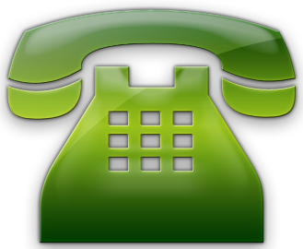
Thank you!
Without your support, the task would be
far harder.
We will endeavour to work together and aim for the highest possible outcomes for our students!
Please keep in touch.

