Slide 1


Year 11 Parents’
Curriculum Evening
Wednesday 10th September 2025
Preparation and Celebration

Slide 2
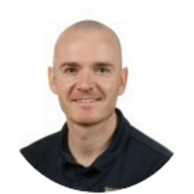
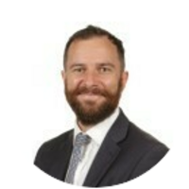
This evening’s schedule
Welcome and prayer
Overview of the year ahead, my vision, attendance, behaviour and expectations (Mr Turner Head of Year 11)
Additional Information:
Revision – relearn, retrieve, rehearse
Students working at home
Where to find curriculum information
Careers talks- post 16 education
Mental and health and wellbeing.
Mr Turner
(Senior Progress Leader- Year 11)
Mr Tatum
(Deputy Headteacher- SLT line manager for Year 11)

Slide 3
Pause for reflection
Lord,
You are the light that guides my feet.
You are the map that gives me direction.
You are the peace that makes me strong.
You are the leader whom I faithfully follow.
May your light illuminate my life
And your guidance bring direction.
May I find inspiration in your word
And peace in my heart as I follow you.
Amen.

Slide 4
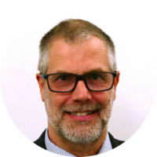
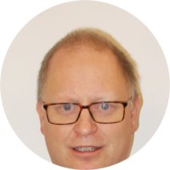
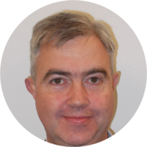
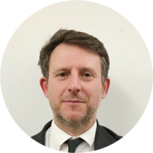
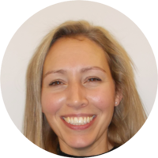
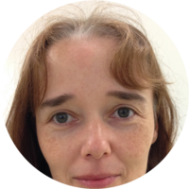
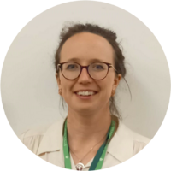
Tutor team –
@st-benedicts.suffolk.sch.uk
11A Mforeman@
11C Nstiff@
11L Dwallace @
11P Jsayer@
11s Pbaker@ & Csevery@
11X Ddunsmore @

Slide 5

Key dates for Year 11
Term 1
Careers Interviews – Ms Hahn
Half-term 1- study skills focus: the “how to” revise aspect of preparation
10th September- Information evening
15-17th September- Year 11 Bradwell Pilgrimage residential
6th form Open evening 21ST October
Half term 2- Subject specific revisions sessions start.
14th-27th Nov Mock examinations – 2xweeks
18th December Mock results and Bowling (TBC)

Slide 6
Key dates for Year 11
Term 2
Half-term 3
subject specific revision sessions increase
13th Jan Yr11 parents evening
9th Feb In class mock examinations – two weeks
Half-term 4
24th -26th Mar futures evenings – invitations to follow
30th Mar – 3rd Apr Easter school

Slide 7
Key dates for Year 11
Term 3
Half-term 5
MAY into JUNE public Examination period (showtime!) These will be sent once the examination dates are confirmed.
Half term 6
18th June provisional Yr11 celebration day and shirt signing
19th June 6th form Transition morning
22nd June- Year 11 Prom - Folk café TBC

Slide 8
My vision for Year 11
Follow expectations and show respect. If you show respect, then this works both ways- I want you to be treated as young adolescents in the school community.
Push yourself out of you comfort zone- challenge yourself to do something to better yourself.
Work Hard and graft: Improve attitude to learning, ask teachers what can we do to get better
Curiosity- be willing to extend your knowledge and know more.
Routines- Consistency and organisation allows you to prepare yourselves better.

Slide 9
What I want Year 11 to leave and be known for…..
I want this year group to continue being a year group that everyone loves to teach. To lead by example as the top of KS4.
If students follow expectations and the visons I have set them, I know you will be ready and prepared for post 16 education and give yourself opportunities in your next steps.
I want students to leave school confident and ready to flourish on the next stages of their education. The hard work starts now, Year 11 is where we should be pushing ourselves to be the best we can be.
If I can implement these visions to them, I will be proud that I have influenced you to be the people you are today and to give you choices when leaving secondary education.

Slide 10
Thie year the same rules apply…
Punctuality - both to school and lessons
Correct equipment to all lessons
Correct uniform!
No phones
Classroom behaviour code – no eating, politeness to all and respect for others and the room
Three step sanction system – warning, move, remove
Homework neat and on time - Arbor
Consider your EBH scores – rewards, references

Slide 11
Expectations- Attendance
We expect students to have a minimum attendance of 96%.
Below 94% and you will be alerted by letter.
If your child is absent then please phone the office and leave a message explaining the absence.
When your child returns to school please send them in with a note confirming the reasons for the absence.

Slide 12
Punctuality
Lateness = Lost Learning*(Figures below are calculated over a school year)
5 minutes late each day | 3 days lost!
10 minutes late each day | 6.5 days lost!
15 minutes late each day | 10 days lost!
20 minutes late each day | 13 days lost!
30 minutes late each day | 19 days lost!
These students will drop AT LEAST ONE GCSE GRADE

Slide 13
Attainment reporting in Year 11
Two assessments for attainment reported end of term 1 and final grade at the end of term 2
Each assessment point will assess both current material and previous work.
Encourage students to prepare for these assessments – helps to build this body of knowledge.
We use low stakes little and often testing in class to ensure information is constantly revisited.
Attainment grades at Christmas and easter will be the grade they received on their mock examinations.

Slide 14
Attitude to learning reporting in Year 11
Early attitude to learning report to give you a prompt indication of how pupils are settling into the new academic year.
Attitude to learning will be reported via a new simplified Effort Grade which will be awarded on a 1 to 3 scale, based on our school values of Compassion, Wisdom and Resilience.
1 = below expected attitude to learning – intervention expected
2 = meets expected attitude to learning
3 = Exceeds expected attitude to learning

Slide 15
Revision: Studying outside the classroom

Slide 16
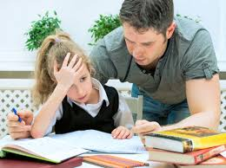
Students working outside the classroom
Students who reported in Year 9 spending between 2 and 3 hours on homework on an average weeknight were almost 10 times more likely to achieve 5 grades of 4 or above than students who did not spend any time on homework.
Just how effective is independent home study………
These results show independent study and effort by students are very important contributors to academic success at GCSE, over and above all other background influences and prior attainment.

Slide 17
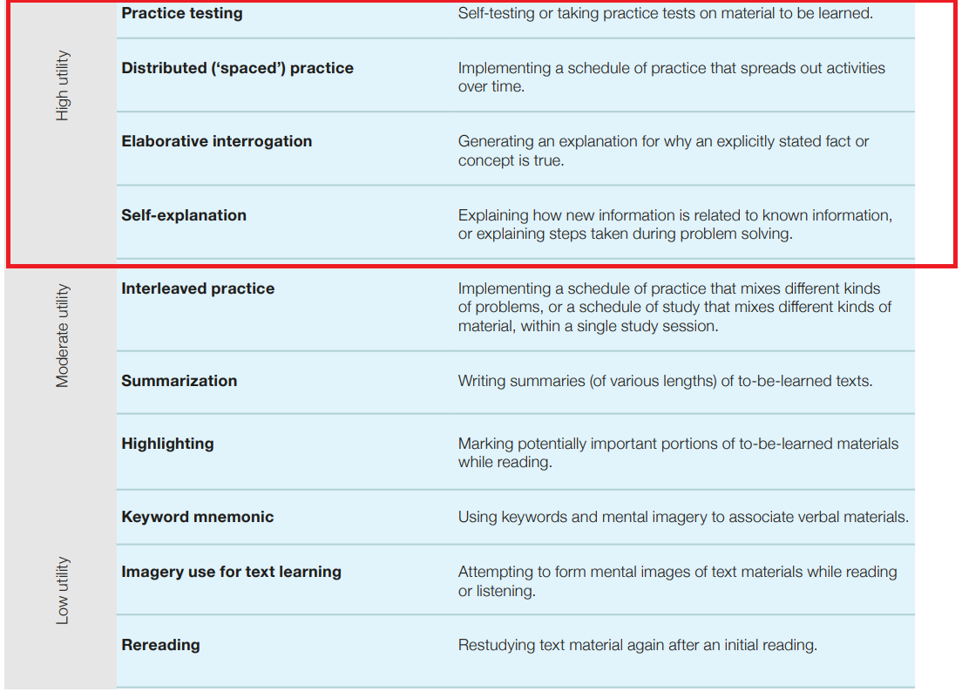
How do we revise?
Effectiveness of ten learning techniques
Dunlosky et al (2013)

Slide 18
How can parents support their child working outside the classroom …
Create a safe place to work at home. Desk/area where you can monitor their work.
Set them a time each evening with no distractions. We recommend 1 hour 30 minutes per night.
This can be split into small sessions of 20-30 minutes allocated to different subjects.
Creating a revision timetable for the upcoming mock examinations in November.
Ensure your child eats food which will supply them with energy and 8 hours sleep a night is crucial during the next year.
Resources available- GCSE POD, Subject knowledge organiser, Revision guide and One note.

Slide 19

BUT!
Any revision is better than no revision and whilst two hours of focused revision alone is more effective than three hours revising with friends, both are more effective than half an hour reading the textbook before getting distracted.

Slide 20
PSHE & Citizenship
Helping students academically and beyond
Key themes we cover within these areas:
Money
Politics
Careers
Study Skills
Health & Safety
Being happy with you are
Being the best person you can be

Slide 21
Careers in Action!
1:1 Post-16 meetings
  min. 1 hour for each student (160 hours!)
  bespoke report
  further meeting(s) as and when required/requested
Support with applications
to Sixth Form/college/ apprenticeships
Information on technical education and training
Ongoing Careers Education:
(PSHE) World of Work series, Careers Talks, annual Careers Fair, Workshops, Trips
Collaboration with all staff to support students

Slide 22
Supporting your
Careers conversations
Sharing more information about post-16 options
  e.g. dates for Open Events, how to find apprenticeships
Helping you understand the language of different systems in education and employment e.g. T-Levels
Updating you directly on latest trends and opportunities in education, training and employment, such as:
  how AI is changing the Careers landscape
  qualifications needed for degree studies
  Contact me at: Ahahn@st-benedicts.suffolk.sch.uk

Slide 23

Thriving not just surviving GCSEs
If only it was always like this………

Slide 24
Mental Health
Experts say it can be easier to talk if you’re doing something else.
Talking whilst Sharing a Meal.
Spending Quality Time together and Talk.
Finding Space to Talk.
Take 5 Minutes To Share.
Talking whilst Cooking Together.
Being There To Help – Just ask “How was your day?”
REMEMBER You are Not Alone - reach out we are all in this together, just be honest.

Slide 25
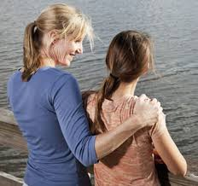

Keeping perspective
But remember be their champion because your support, encouragement and interest will be there long after this exam period is over.

Slide 26

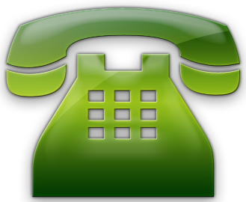
Thank you!
Preparation and Celebration
Without your support, the task would be
far harder.
We will endeavour to work together and aim for the highest possible outcomes for our students!
Please keep in touch…

