Slide 1



Year 9
2025/26
Parent information Evening
Senior Progress Leader - Mr Wilson gwilson@st-benedicts.suffolk.sch.uk
Assistant Head Teacher - Ms Coogan
ECoogan@st-benedicts.suffolk.sch.uk

Slide 2
Pause for reflection
Lord,
You are the light that guides my feet.
You are the map that gives me direction.
You are the peace that makes me strong.
You are the leader whom I faithfully follow.
May your light illuminate my life
And your guidance bring direction.
May I find inspiration in your word
And peace in my heart as I follow you.
St. Benedict … pray for us.
Amen.

Slide 3
Tutors
Please contact your child’s tutor in the first instance of an issue/question, they will always be the first person in the day to see them in a day, and can usually resolve most things fairly quickly. Issues of a serious nature they will refer up to myself to investigate/help with.
9A – Miss Whittingdale - AWhittingdale@st-benedicts.suffolk.sch.uk
9C – Mrs Chacksfield CChacksfield@st-benedicts.suffolk.sch.uk
9L – Mr Hempel JHempel@st-benedicts.suffolk.sch.uk
9P – Mrs Rooney NRooney@st-benedicts.suffolk.sch.uk
9S – Mr Elmer AElmer@st-benedicts.suffolk.sch.uk
9X – Mrs Blewitt RBlewitt@st-benedicts.suffolk.sch.uk

Slide 4
Same rules apply…
Punctuality - both to school and to lessons
Correct equipment to all lessons
Correct uniform – Also worn correctly
No phones
Classroom behaviour code Three step sanction system – warning, behaviour point, remove
We operate daily lunch detentions in E3 with the Heads of Year. 20 minutes for uniform issues, 40 minutes for removal from class.
We operate twice weekly after school detentions, Wednesday for 60 minutes with Teaching staff, and Friday for either 60/90 minutes with SLT. Both start 3:45 and either go to 4:45 or 5:15pm.
Homework neat and on time - Arbor
Notes:
Three step sanction system. Warning, move, remove. If the student is removed they spend the rest of that lesson in isolation. If this happens again during the day = remain in isolation.
Removal from lesson = an email will be sent home to inform you that ASD will take place the next day.

Slide 5
Uniform
We have not changed our expectations around uniform from last year.
The behaviour system contains a Uniform Code behaviour point
In general the issue with uniform is not that pupils don’t have the correct uniform, it is that it is not being worn properly.
  Shirts are tucked in.
  Skirts worn correctly, not rolled up or altered.
  No Hoodies or non-uniform jumpers.
If there is a problem with uniform (ie school shoes not fitting anymore), just please make sure to communicate with us. An email to tutor, or a hand-written note, and the tutor can issue a green card first thing in the morning. Where issues come in it tends to be when things are left.

Slide 6
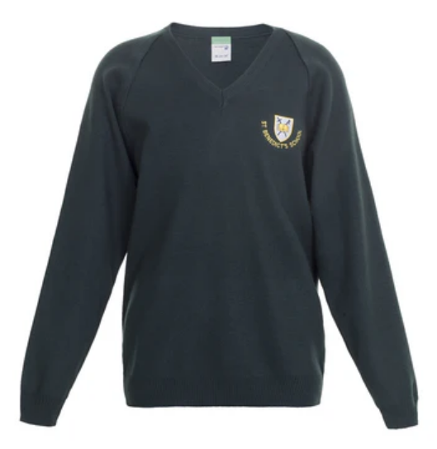
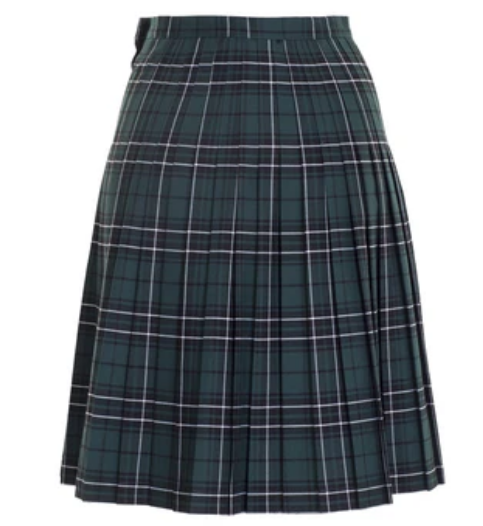
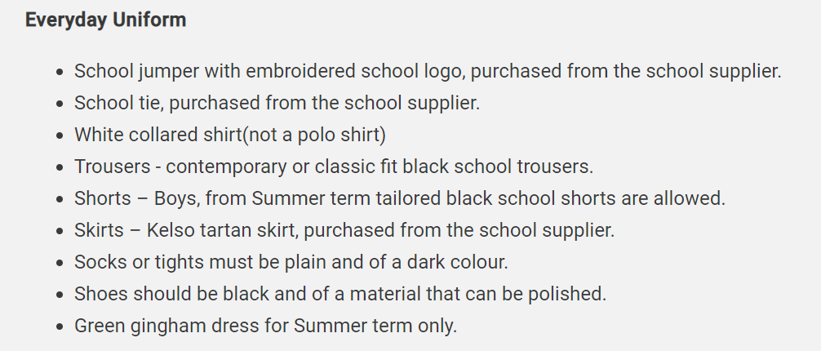
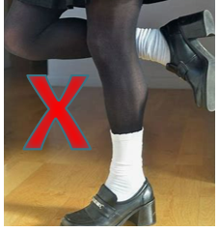
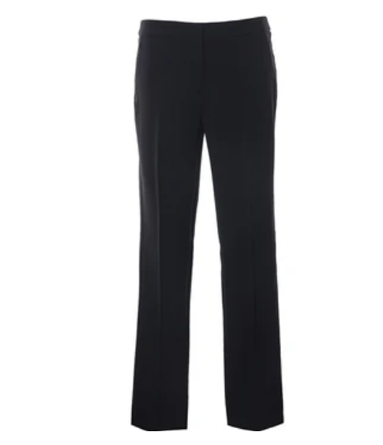

Uniform expectations

Slide 7

Attendance
“One day off a fortnight…that’s not too bad?”
1 day lost per fortnight = 4 weeks of school over the year
4 lost weeks of school = 120 lessons
Over 5 years of schooling 90% attendance = ½ a YEAR of education lost
Less than 50% chance of achieving the government benchmark of 5+ 9-4 Grades

Slide 8
Attendance
How attendance affects your chances of success at GCSE
Notes:
You will see from the graph how drastically attendance affects attainment.
90% attendance is 1 day off per fortnight.
1 day lost per fortnight = 4 weeks of school over the year
4 lost weeks of school = 100 lessons
Over 5 years of schooling 90% attendance = ½ a YEAR of education lost .

Slide 9
Parent Evenings and Options evening
Option selection evening will be Thursday 5th of February.
A lot more information will come out about that closer to the time from myself and Mr Tatum our Deputy Head.
Parent teacher interviews for year 9 will be Thursday 12th of February. They are timed this way to help you with option selection.
Books are made via Arbor. Interviews are 5 minutes long with each teacher.
The bookings will go live 2 weeks before the event and close the day before the event.
Most of the appointments will be here in the school hall, with a few over following in the drama studio next door.
Please can the student attend as well. Given option selection, it is very important they hear what their teachers have to say.

Slide 10
Careers support with Options
Miss Hahn, our Head of Careers, provides Information, Advice and Guidance (IAG) on career-related subject choices
Students can book an appointment with Miss Hahn during school hours to review entry requirements for future education, training and employment pathways
Work experience in Year 10 offers students an opportunity to trial options pathways in person.

Slide 11
Attitude to Learning (ATL) in Year 9
We have a system of attitude to learning grades (ATL)
You will receive a report from us at the end of each half term with an ATL grade for each subject.
They are intended to give you an idea of your child's pattern of attitude and effort in the subject.
These grades are from a 1 to a 3. A grade 2 indicates expected and acceptable attitude to learning. A 3 indicates outstanding attitude, and a grade 1 indicates unacceptable attitude to learning.
The intention of these reports is to start conversation with your children, to celebrate what is going well and how you can support what isn’t.

Slide 12
ATL Descriptors
ATL Score | Meaning | Intervention Needed
3 | Always Meets and Often exceeds Expected ATL | No
2 | Meets Expected ATL | No
1 | Below Expected ATL | Yes

Slide 13
ATL Interventions
Levels of Intervention | Trigger | Action
Level 1 Tutor | Attitude to Learning report A patter of low ATL scores. Usually 3 or more ATL scores of a 1 | Tutor intervention report card Tutor to monitor during AM and PM registration Runs for 2 weeks in the first instance Teachers give the student an ATL score for each lesson
Level 2 SPL | Attitude to learning report. A very high pattern of low ATL scores Or Failure of a report to Tutor | Report directly to Senior Progress Leader Meeting with parents Runs for 2 weeks in the first instance Teachers give the student an ATL score for each lesson
Level 3 SPSF | Failure to complete Level 2 successfully | A personalised support plan with the Senior Progress Leader Meeting with parents on 2/3 week basis Runs for 6 weeks Report with personalised targets Report daily to SPL

Slide 14
Assessment Points
Alongside the attitude to learning reports, you will receive three reports which also contain assessment information.
Assessment point 1 will be based on assessment data from throughout half term 1 and 2, and be sent just before Christmas.
Assessment point 2 will be based on assessment data from throughout half term 3 and 4, and be sent just before Easter.
Assessment point 3 will be based on assessment data from throughout half term 5 and 6, and be sent just before summer.
These will be a lettered grade between 9B and 9M

Slide 15
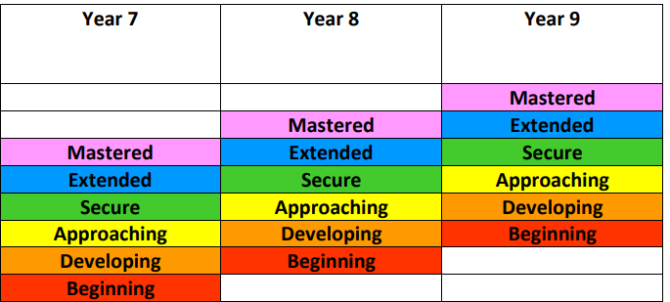
Progress Through KS3

Slide 16
Assessment
Ks3 Grading System
9M | Mastered | Demonstrated a comprehensive understanding of all concepts and skills in a unit of work.
9E | Extended | Grasped the main concepts and skills in a unit of work and can apply to new contexts.
9S | Secure | Has a secure understanding of the main concepts and skills when applied to familiar contexts.
9A | Approaching | Grasped most of the main concepts and skills in a unit of work and is approaching ‘secure’.
9D | Developing | Grasped some of the main ideas and skills in a unit of work but others require development.
9B | Beginning | Beginning to grasp some of the main ideas and skills in a unit of work.

Slide 17
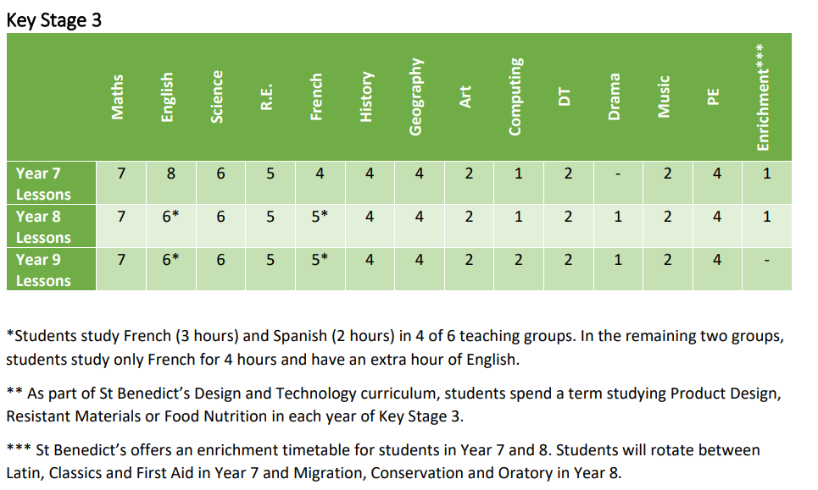
Time Table

Slide 18
English
Year 9 Autumn | Gothic Writing A Christmas Carol Opinion Piece writing (continues to Spring term)
Year 9 Spring | Dystopian Reading Shakespeare
Year 9 Summer | Shakespeare (continued) ‘Worlds and Lives’ poetry anthology (part 1)
GCSE content begins in Year 9 English
A Christmas Carol is a GCSE unit pupils will be examined on in 2028.
Worlds and lives poetry is also GCSE content, pupils will do the first 5 of 15 poems they need to learn.

Slide 19
Maths
Year 9 half Term 1 (Autumn) | Sequences, functions & graphs Fractions, decimals & %; ratio & Proportion Angles & constructions
Year 9 half Term 2 (Autumn) | Equations, formulae & identities Surveys & interpretations
Year 9 half Term 3 (Spring) | Place value & using a calculator efficiently Measures & mensuration
Year 9 half Term 4 (Spring) | Integers, powers & roots Probability
Year 9 half Term 5 (Summer) | Transformations Compound measures Pythagoras’s theorem Revision & Exams
Year 9 half Term 6 (Summer) | Financial capability & Investigations distance/time/speed graphs Similarity & basic trigonometry Types of number & Investigations
*Maths in year 9 is focused on setting pupils up with numeracy skills ready to begin GCSE content next year.
* End of year testing will begin to determine sets, with a view towards pupils who will attempt higher or foundation papers.

Slide 20
Science
Year 9 half term 1 (Autumn) | B1.1 Microscopy B1.2 Cells
 | C1 Particles
 | P1.1 The particle model
Year 9 half term 2 (Autumn) | B1.3 Respiration B1.4 Photosynthesis
 | P1.1 The particle model (contd) P1.2 Changes of State P1.3 Pressure
Year 9 half term 3 (Spring) | C2.1 Purity and separating mixtures C2.2 Bonding
 | P2.1 Motion
Year 9 half term 4 (Spring) | C2.2 Bonding (contd) C2.3 Properties of materials
 | P2.2 Newton’s Laws
Year 9 half term 5 (Summer) | B2.1 Supplying the cell
 | P2.2 (contd) P2.3 Forces in action
Year 9 half term 6 (Summer) | B2.2 The challenges of size
 | P2.3 Forces in action (contd)
*You will note all 3 sciences are woven together for the pupils at this level, with units on Biology, Chemistry and Physics throughout the year.
* This is the final year of that arrangement, next year the science disciplines will split off.
* End of year testing will begin to determine sets, with a view to which pupils will be combined science candidates, and which triple sciences.

Slide 21
RE
Half Term 1 | Judaism- Beliefs and Teachings
Half Term 2 | Mark’s Gospel
Half Term 3 | Misconceptions and Church Teaching
Half Term 4 | Catholic Social Teaching
Half Term 5 | Mission of the Church
Half Term 6 | Big Questions/ Problem of Evil
Half Term 6 | Sex Education
RE lessons will focus on building students academic capacity in the subject, to prepare them for their GCSE studies in the subject. RE is a required GCSE subject for all pupils at St Benedict's.

Slide 22
French
Year 9 half term 1 (Autumn) | Ma vie social d’ado- Social media in our lives, social life
Year 9 half term 2 (Autumn) | Le monde Francophone- The French speaking world
Year 9 half term 3 (Spring) | A l’horizon- Jobs and future plans
Year 9 half term 4 (Spring) | Spécial Vacances- holidays, tourism
Year 9 half term 5 (Summer) | Bien dans sa peau – Health and healthy lifestyle
Year 9 half term 6 (Summer) | La Musique Francophone - Different genres of Francophone music
*Year 9 French is to prepare pupils to be ready to sit a GCSE in French. The standard expectation is that all pupils at St Benedict’s will study a second language at GCSE. There is a small group who do not, but this is not an opt in group, but decided by our SENDCO based on learning needs.

Slide 23
PSHE
Year 9 half term 1 (Autumn) | Essential Skills
 | Conflict management
 | Give 2 Good
 | Bringing about change
Year 9 half term 2 (Autumn) | Problem solving
 | Money management
 | Financial dilemmas
 | Harmful substances
Year 9 half term 3 (Spring) | Taking responsibility
 | Be safe and kind
 | Knife crime
Year 9 half term 4 (Spring) | My troubled mind
 | Mock Trial
Year 9 half term 5 (Summer) | Grief
 | Achieving your goals
 | Using your gifts
 | Knowing you
Year 9 half term 6 (Summer) | Which job?
We continue the PSHE curriculum with 1 lesson in a two weekly cycle and a dedicated teacher. This continues to be a core part of the pupils wider education, and continues throughout KS4.

Slide 24
History
Year 9 half Term 1 (Autumn) | 1 Slavery (Overview)
Year 9 half Term 2 (Autumn) | 2 First World War (Depth study)
Year 9 half Term 3 (Spring) | 3 Inter War Years (Depth study)
Year 9 half Term 4 (Spring) | 4 Holocaust (Depth study)
Year 9 half Term 5 (Summer) | 5 WWII and the Home Front (Depth study)
Year 9 half Term 6 (Summer) | 6 Post War Britain (Overview)
GCSE history begins in year 9, with Inter War Years their first GCSE topic
Topics such as the Holocaust are intentionally saved till this year to give students the maturity to engage and learn from such a horrifying event.
At the end of this year, pupils will have a choice moving forward between History and Geography.

Slide 25
Geography
Year 9 half term 1 (Autumn) | Population and migration
Year 9 half term 2 (Autumn) | Oceans
Year 9 half term 3 (Spring) | Globalisation and Tourism
Year 9 half term 4 (Spring) | Overview of Landscapes of the UK
Year 9 half term 5 (Summer) | Coastal Landscapes
Year 9 half term 6 (Summer) | River landscapes
*GCSE content begins in Geography this year, with the first 3 units finishing up KS3, and the final 3 half terms being the beginning of GCSE content.
* At the end of this year, pupils will have a choice of humanities subject between Geography and History

Slide 26
PE
Half-Term | Sports covered
Autumn 1 | Football and Health & Fitness
Autumn 2 | Rugby and Volleyball
Spring 1 | Basketball and Hockey
Spring 2 | Table Tennis and Handball
Summer 1 | Athletics and Cricket
Summer 2 | Athletics and Rounders
* Pupils will have 4 lessons of PE in a 2 week cycle.
* At the end of this year, GCSE PE will be an option for pupils to take. However, all pupils will continue with core PE for their entire time at school.

Slide 27
Art
Year 9 half term 1 (Autumn) | Pop Art Drawing Colour media Studies Artist analysis Lichtenstein painting Ceramic cake form Chalk pastel
Year 9 half term 2 (Autumn) | Pop Art – continued Still life drawing Collograph printing Photo editing Painting – monotone colours Textiles
Year 9 half term 3 (Spring) | Picasso Portraiture drawing Picasso analysis Colour – oil pastel
Year 9 half term 4 (Spring) | Picasso – continued Ceramic plate Cubism Pastel study
Year 9 half term 5 (Summer) | Modern Sculpture Research – understanding sculpture principals Louise Nevelson - Assemblages
Year 9 half term 6 (Summer) | Modern Sculpture – continued Henry Moore Contour line drawing Wax resist Printing
The fundamental skills for this years Art curriculum is drawing, which is examined in a variety of different forms.
Art will be an option subject pupils can pick option selection.

Slide 28
Computing
Year 9 Term 1 (Autumn) | Procedural Programming with Python
Year 9 Term 2 (Spring) | Computational Thinking, Algorithms and Abstraction
Year 9 Term 3 (Summer) | Relational Database
The skills focus for this year in Computing is on programming. Pupils will explore this is a number of different ways, giving them a strong skills basis if they decide to pursue the subject at GCSE.

Slide 29
Music
Year 9 Term 1 (Autumn) | Song Writing
Year 9 Term 2 (Spring) | Music Technology
Year 9 Term 3 (Summer) | Battle of the bands
The subject covers core fundamentals needed in performance music at GCSE, to ensure pupils have a strong grounding in music, and for those who will select it as an option subject to ensure they have the skills required.

Slide 30
Design and Technology
Year 9 | Autumn 1 | Autumn 2 | Spring 1 | Spring 2 | Summer 1 | Summer 2
Topic | Food Technology | Food Technology | Product Design Biomimicry Architecture | Product Design Biomimicry Architecture | Textiles T-Shirt Upcycling | Textiles Recycling Weaving
Key Knowledge | Food Classification & grouping Nutrition & balanced diets Food Safety/Hygiene | Specialised Diets Culture significance through Cuisine Traditional dishes | Concept of Biomimicry Examples of Biomimetic Architecture Design process | Structural integrity Selecting materials Properties of materials Construction methods | Impact of Fast Fashion and Plastic Waste Sustainable design principles | Upcycling techniques Designing for social and environmental messaging

Slide 31
Arbor
We are continuing our pupil management system of Arbor. Hopefully you’ve all used to it by now.
Arbor will automatically send emails to parents to advise of incidents – these may not result in a behaviour mark, but are important for parents to be aware
All homework will be set on Arbor, but usually isn’t handed in there.

Slide 32
One Note
One note is a IT system used to support classwork. Teachers will create class notebooks, and upload class material to there.
They may ask students to submit work via one note.
The log in details are exactly the same as the details needed to log onto the schools system.
If your child misses lessons, there will be work there to enable them to catch up.
To support their learning at home, it would be really good if you can support them in getting onto this platform, and help them in learning to use it.
Support is available with using it via our website, or you can always contact the school to get support from our IT technician.

Slide 33

Contributing to your House
Each House point you gain contributes to overall score.
Each behaviour point deducts a House point from total.
Complete the St Benedict’s Award.
Participate in House competitions.
Support your peers within your House.

Slide 34
Clubs
We have a brilliant range of clubs on offer, including a huge range of interests.
The extra-curricular timetable is available on Arbor, and you can sign your child up to the club there. Doing that will make the club appear on their timetable, and also add them to the teachers register.
They are of course welcome to head along and try out a club before signing up for it, we just ask that once they decide to start going regularly you sign them up on Arbor.
We have made a real effort to get a good range of clubs available to the students. Our expectation is that every student is undertaking at least one extra-curricular activity regularly.
We really appreciate your support with this

Slide 35
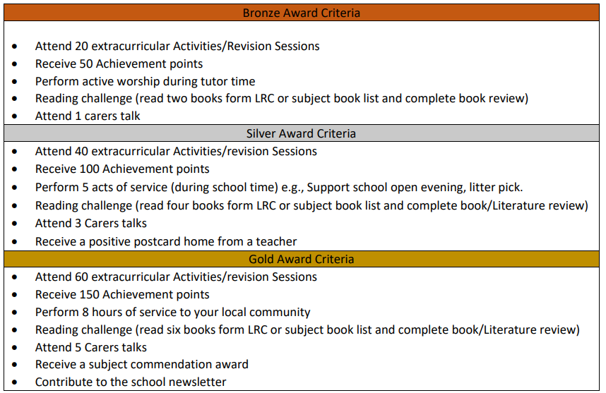
St Benedict's Award

Slide 36
Social Media
Year 9 is often the time when social media usage starts to become highly problematic.
What we find is that social issues are often hugely magnified by social media, and often minor issues outside of school can become much larger.
A lot of this is caused by our young people still not being ready to communicate unsupported or supervised on these sorts of platforms.
The pupils still do not meet the age requirements on the platforms for use of most social media types.
If you have made the decision as a parent to allow your child to use these platforms, I really want to encourage you to offer them support and guidance on how to use them in a healthy way, rather than just leaving them to it.

Slide 37
Social Media Advise
Make sure you are aware of the different types of Social media your child has, and what they are using them for. Have oversight of passwords and accounts.
At times, go through their social media with them, to make sure you are happy with the content they are accessing and posting. Have a look at group chat conversations. Do this regularly, and not just when something goes really wrong.
Give your child a time limit on their devices, and take them in at the end of the day. Unrestricted access, particularly late at night can be very unhealthy.
Establish a line of communication with your child, where they feel comfortable coming and talking to you about their social media. If they feel your interested and engaged with that part of their life, chances are they will come to you when they need help. If they feel its something they are always in trouble for, they won’t reach out when they do need help.

Slide 38


Thank you!
Without your support, the task would be
far harder.
We will endeavour to work together and aim for the highest possible outcomes for our students!
Please keep in touch.

