Slide 1

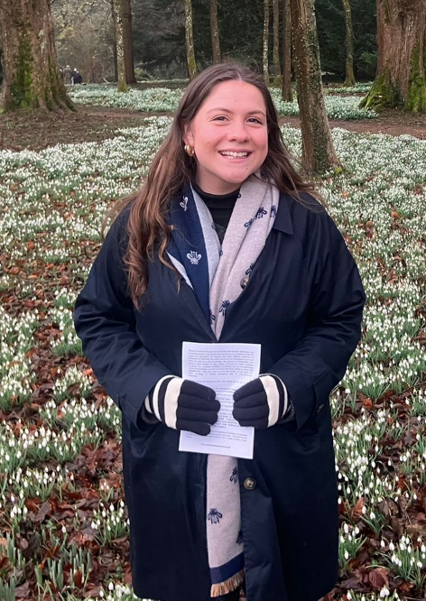

A Career in Ecology with Beatrix Hayter-Gare
Alumni Careers Talk
ALL Welcome
Wednesday 15th October at 12.45-1.25pm in G2
Former student Beatrix (Bea) works as an Ecologist at West Suffolk Council. Her passion is to understand the biology and geography of our local area and to protect the green spaces and habitats that support wildlife and people alike. Bea’s work allows her to turn her passion into real action for conservation. Bea is delighted to return to St Benedict’s and meet the next generation of young people who share the aspiration of making a difference for the environment.

