Slide 1

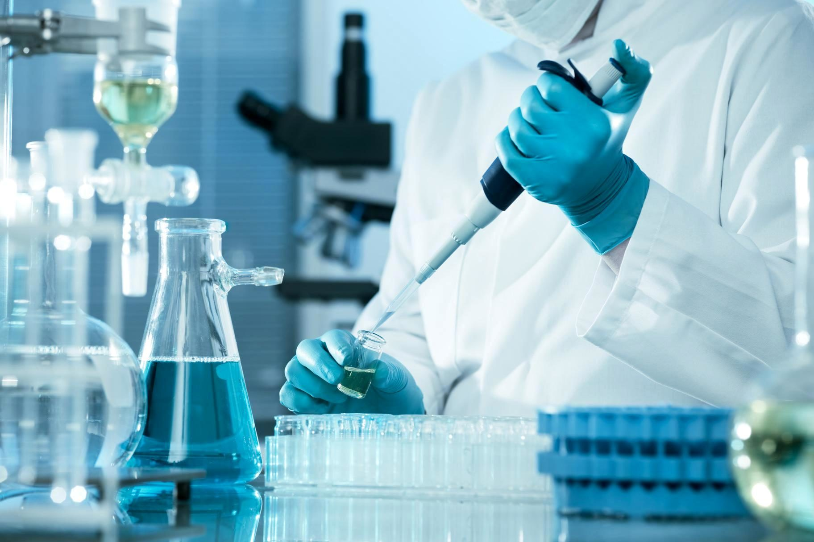
An International Career in Medical Laboratory Science
Careers Talk
ALL Welcome
Thursday 25th September at 12.45-1.25pm in G2
After completing his Science A Levels, Jonathan Gregory began a career as a hospital pathology technician. He continued his studies in Medical Laboratory Science and, after 10yrs within NHS pathology, moved to Riyadh (Saudi Arabia) to work in a large hospital there. Jonathan returned to the UK 6 years later to continue his career as a technical specialist for a company supplying hospitals, veterinary practices and water providers with technical equipment and services.
Jonathan is keen to share his career experiences… and encourage you
to be ready to change direction to exploit new opportunities!

