Slide 1

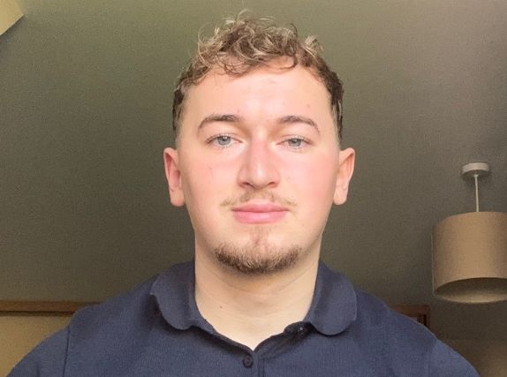
Project Management in Nuclear Energy with Dan Bourne
Alumni Careers Talk
ALL Welcome
Tuesday 10th February at 12.45-1.25pm in G2
After graduating from St. Benedict’s in 2020, Dan gained a 1st class degree in Business from Nottingham Trent University. He then decided to work part-time to fund his travels, explore different environments, and compete in MMA!
On his return to the UK, Dan entered a competitive selection process and successfully secured a graduate Project Management role with Mace Consult. Since October 2025, Dan has been working on Sizewell C - the only giga project in the UK currently worth more than £40bn!
Find out more about Dan’s career path and join his Q&A session on 10th Feb!

