Slide 1

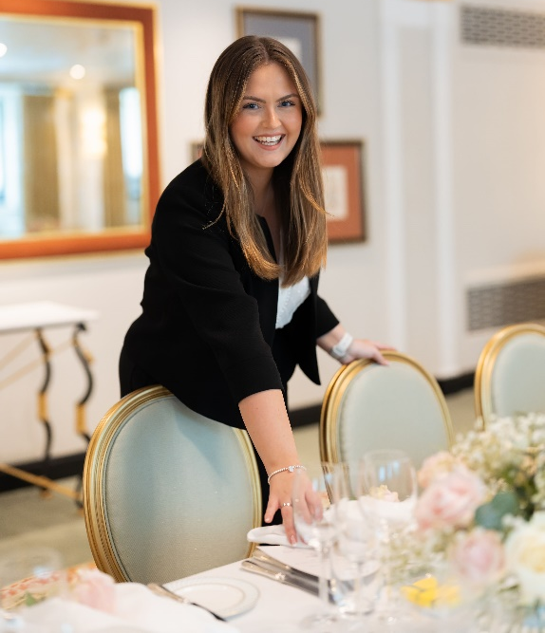
A Career in High-end
Events Management with Lauren Buckley
Alumni Careers Talk
ALL Welcome
Friday 1st May at 12.45-1.25pm in A3
Former student, Lauren Buckley is the Social Events Manager at the luxury 5 Star Dorchester Hotel in Park Lane, London – a role she is truly passionate about. Lauren will share her experience and insights about working in Social Events Management and high-end hospitality. She will also talk about her unconventional career path and the challenges she faced with a late ADHD diagnosis.

