Slide 1



An introduction to Apprenticeships for students
Notes:
Hello Everyone, my name is Fred and I am a school engagement coordinator for the AIM group, and we are funded by the National apprenticeship service. I am here to talk to you today about apprenticeships.
This Is not to say that this is the option you MUST choose. You are able to apply to university or sixth form the same time as applying for an apprenticeship. My suggestion is to apply for both. It is better to have too many options than too few. Either path has its own positive and negative aspects. Apprenticeships are a good and viable option worth considering. In recent years the governments has introduced many new measures and input more funding into developing and enhancing the apprenticeship programme, so it is constantly growing and evolving.

Slide 2
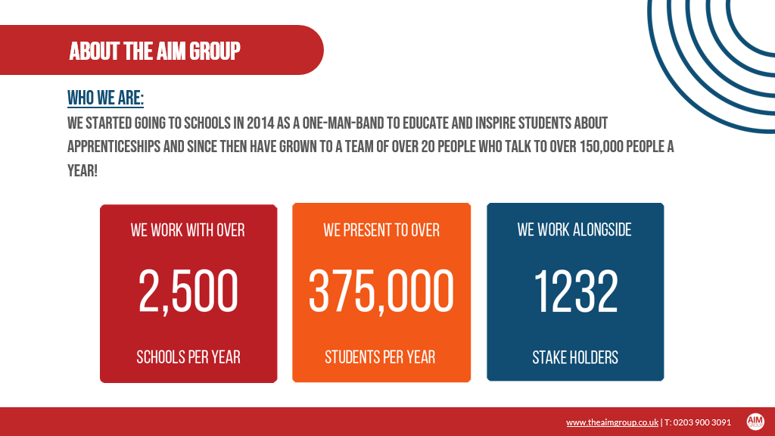
Notes:
So, just a little bit about us to start. As a company we work alongside CXK and ASK to expand knowledge on higher degree education opportunities. We work across the country presenting to schools to deliver this message.

Slide 3





What are apprenticeships?
Earn a wage
Work for at least
30 hours per week
Study towards a
job related qualification
Contract of employment
including holiday pay
Real job with
real responsibilities
Notes:
Apprenticeships are an alternative higher education offer for anyone 16 or over. There is no upper age limit to start an apprenticeship. It takes a minimum of one year and up to six years.
The apprenticeship itself has two parts. 80% working with an employer and 20% learning with a training provider.
Whilst working you will receive a contract of employment. An apprenticeship is first and foremost a job. You will be expected to be there on time every day and work to the best of your abilities. You won’t just be making the tea and coffee. It is possible to get fired from an apprenticeship, but you can also get promoted or receive a salary increase. The minimum amount of hours you will work a week is 30 hours, the maximum is 40 hours. You will be earning a wage while you do your apprenticeship, the minimum wage for a first year apprentice is £4.15 an hour. Now I know that doesn’t sound like a lot, but remember if you were in another form of higher education you would not be earning at all. Also this is only the minimum wage for your first year, the minimum goes up with your age and years of experience. Plus the good news is the majority of employers pay more than this anyway!
20% of the time you will be learning with a training provider such as a college or university. This will be working up to gaining a qualification (we will expand on the level of qualifications you can gain in a moment). There are no fees to pay for your education, so whilst doing an apprenticeship you will be putting money in your pocket rather than being in debt. Every apprenticeship is unique and will be done a different way. That is one reason why it is important to research.
At the end of your apprenticeship you will be required to do an end point assessment, this could be done in the form of; a practical assessment, an interview, a project, a written or multi choice exam, or a presentation.
When researching apprenticeships, it is important you keep in mind travelling. Try to be realistic in what you think you can commute every day. It is important you get to work on time everyday, so make sure both your workplace and your training provider are easily accessible to you.

Slide 4
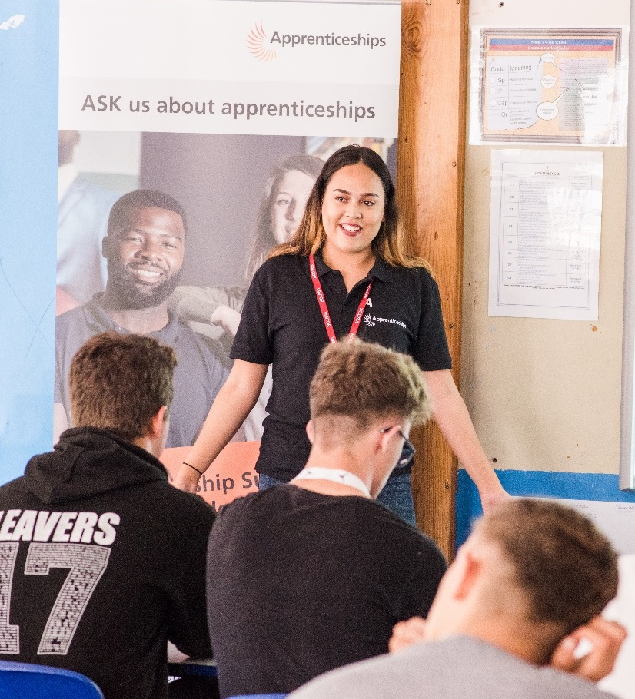

The truth about apprenticeships
EARN A
GAIN A
SALARY
DEGREE
90%
NO FEES
STAY IN
WORK
TO PAY
POST-APPRENTICESHIP
YOU CAN
Social life?
RELOCATE
NOT THE EASY ROUTE
Notes:
You will not miss out on having a social life whilst doing an apprenticeship either, in fact being in both a work and a training environment means you will get two different locations to meet new people!
What happens after you finish your apprenticeship? Well 90% of apprentices stay with their employer after they finish. That is almost a guaranteed job! So why is this? Well the company who has employed you has spent a lot of time and money creating their perfect employee. They have trained you to work within their company so they will not want to let you go! Those who do go on to other opportunities will have the work experience and the qualification to move on with ease.
Apprenticeships are available all across the country, so you will be able to relocate if you wish. I would like to emphasize that they are not the easy option you can fall back on if you don’t get into university or sixth form. The application process for an apprenticeship is long and extremely competitive as each is a sought after opportunity and role. The apprenticeship itself requires you to balance both sides of your working and learning life. These are all points to consider when thinking about apprenticeships. They are an amazing option available but they are not the failsafe. I will keep repeating this but it is important to research and keep up to date on the positions and the companies offering apprenticeships, finding out their opening and closing dates as opportunities appear and disappear fast.

Slide 5






The range of apprenticeships
Accounting
Aviation
Horticulture
Architect
Creative & Digital
Teaching
Cyber Security
Surveying
Project management
Nursing
Dental Nursing
Hospitality
Hairdressing
Legal Services
Journalism
And many more….
Notes:
Years back apprenticeships would have been focused mainly on trades, such as an electrician, plumber or beautician. You can still do all these options now, and more! There are hundreds of different apprenticeships available, with more being developed and rolled out each year. You can now do apprenticeships such as; nursing, teaching, architecture or becoming a solicitor.

Slide 6






























Which employers offer apprenticeships?
Notes:
A huge range of companies offer apprenticeship opportunities. 50% of the time it will be global household names such as the ones currently on the screen, and the other 50% of the time it will be local smaller companies. One is not better than the other, in both small and large companies you would be gaining a qualification and getting work experience. You would need to consider what type of company you think you would suit more when doing your research.
Applications for an apprenticeship are different from applying to a sixth form or a university. There is no set application date, companies only advertise when they want an apprenticeship so their application processes are all individual. They are open all at different times and for different lengths so it is important if you were interested in a particular company to research when and for how long their applications are open. Opportunities for starting at Coca-Cola in September 2021 the applications are open this year in September-December. The telegraph is only opening its applications for 4 weeks, whereas NHS applications are open all year round. Some applications will be open until positions are filled. This is why it is important to research apprenticeship opportunities, and continue to check.
You are able to apply to as many apprenticeship opportunities as you would like, there is no limitation, and are also able to apply for university at the same time, which once again we suggest. Companies will offer different benefits for their employees, such as work phones, the opportunities to gain more holiday days, or even pets at work schemes.

Slide 7

Look inside the company!
Logistics
IT and Cyber Security
Data Analytics
Sales
Business Development
Marketing
Human Resources (HR)
Finance
Legal
Facilities Management
Security
Customer Service
Training and Development
Notes:
Say you wanted to go into accounting, you might say to yourself ‘I won’t apply for Starbucks as I don’t want to be a barista’ Being a barista is not the only opportunity Starbucks would have to offer. Every single company has several different departments within it; human resources, marketing an IT department etc…
All with its own apprenticeship opportunities. Don’t get bogged down on what you feel the company is. Each apprenticeship will have its own unique job title set by the employer. Again don’t let first impressions sway your opinion, job titles may look boring but it is important to read more about the job details as it may be exactly what you are looking for!

Slide 8





The levels of apprenticeships
LEVEL
LEVEL
Intermediate
apprenticeship
Level 2
Advanced apprenticeship
Level 3
Higher apprenticeship
Level 4-7
Degree apprenticeship
Level 6 & 7
Intermediate
apprenticeship
Level 2
Advanced apprenticeship
Level 3
Higher apprenticeship
Level 4-7
Degree apprenticeship
Level 6 & 7
SKILLS, KNOWLEDGE & BEHAVIOURS
SKILLS, KNOWLEDGE & BEHAVIOURS
Notes:
There are different levels of apprenticeships that equate to different qualifications. Level 2 is equivalent to 5 GCSE passes, level 3 equates to 2 A level passes, it is then that we start going into the higher and degree level apprenticeships. Level 4 equals a higher national certificate of a higher national diploma. Level 5 is a foundation level degree, level 6 a bachelor degree level and a level 7 a masters or a post graduate degree.
As for the requirements you will need for each level the answer is not as clear cut. Though I can give you a general idea of what level needs, it is up to the discretion of the employer on what qualifications they will ask for. Level 2 for example often does not have any qualification requirements, and if you do not have your GCSE maths or English when starting a level 2 apprenticeship, you will be able to work towards English and maths functional skills during the apprenticeship. Level 3 usually requires GCSEs and level 4 and above A levels. But again these are all unique and dependant on the apprenticeship itself. When completing a level 3 apprenticeship you would then be eligible to do a level 4 apprenticeship in the same area. In fact your employer may offer you this opportunity after you finish.
As this is a job first and foremost, work experience is also a relevant factor. Say you want to become a chef and you have catering experience, you may be able to skip straight to a level 4, without the relevant qualifications.
Each level has different opportunities within it.. If you are interested in a particular role, such as teaching, you will need to research which level you will need to achieve.

Slide 9




Different delivery models
Workplace learning
Online learning
20% of your paid time for off-the-job
learning
Classroom learning
Attend college or training provider
Notes:
There are different ways this training can take place, this 20% could occur by having a training session once every week or learning for 6 weeks straight and then working the rest of the time. You can also be trained in different ways, such as being trained on site at the workplace, online learning or classroom learning. Every apprenticeship is unique and will be done a different way. That is one reason why it is important to research.

Slide 10

How do apprenticeships compare to full time university?
HIGHER AND DEGREE
APPRENTICESHIPS
Work full time and study part-time
100+ UNIVERSITIES
Learning
Salary
No Debt
NUS
Experience
4-6 Years
University fees paid by employer and/or government
Notes:
If you held up a university degree in one hand and an apprenticeship degree in the other, there is absolutely no difference. The degree you gain is the same from either opportunity. With an apprenticeship degree you will also have all the benefits of being a university student; getting a graduation ceremony, as well as an NUS card entitling you to student discounts in major high street chains. Whilst learning 20% of the time with the university you will still get to have a social life, meeting people both at university and the workplace you will also be able to join university socials.
Some people worry that in doing an apprenticeship you will not get the same level of variation in your learning. Though in some apprenticeships you will be working in the same department, in companies such as BT they allow their apprentices to rotate through all different departments in the company.
Rather than having to pay a student loan, you will instead be being paid a wage. The average starting wage for a apprenticeship degree is £17,800 a year, you will be able to put money in your pocket throughout your degree rather than paying out of it.
You will also be gaining work experience whilst you gain your qualification, an option not open to most university students except those who do a placement year. If you decide to move on from your employer (as only 10% do, remember that high rate of employability we discussed before) this work experience is essential in getting a job.
Though university students get the summer holidays off, you will be given holiday allowance in your employment contract. However it is very likely you will be doing more hours than a university student per week, as the minimum requirement for an apprentice is 30 hours a week. Subject dependent some university students could have as little as 8 hours contact time a week.
Doing a degree through the apprenticeship route does mean it is likely to take longer than a usual degree. With it taking 4 to 6 years rather than the average 3 years. But do remember whilst you are taking this longer path, you get the benefits of work experience, earning a wage, an almost guaranteed job at the end, and no student debt.
Apprenticeship degrees are also listed on UCAS and are available in hundreds of universities across the country, with the availability growing every year. It is worth noting that whilst apprenticeship degrees do start usually in September, that is not always the case, and opportunities and deadline dates are not the same as each other, unlike applying for a regular university degree.

Slide 11

Are there any jobs?
How many vacancies are near me?
Vacancies
In your area:
5 miles =29 vacancies
10 miles =61 vacancies
15 miles =140 vacancies
20 miles =295 vacancies
Notes:
1. Before this presentation I looked for apprenticeship vacancies available near you at the moment, this is what I found…
5 miles =29 vacancies
10 miles =61 vacancies
15 miles =140 vacancies
20 miles =295 vacancies
This is a great deal of opportunities, especially considering the current job climate we are in. As said before you must set realistic standards when it comes to how far you are willing to travel.

Slide 12
Apprenticeship jobs in the local area
Job opportunity | Weekly salary
Retail Assistant | £221.25
Web developer | £175.00
Dental nurse | £261.60
Nissan Light vehicle technician | £166.00
Personal Assistant | £300.00
Hospitality | £193.50
Notes:
2.There are a variation of apprenticeship opportunities just within 20 miles, all with different salaries, different levels, and different start dates. Here is a sample of some of the opportunities near you at the moment…
Retail assistant £221.25 weekly
Web developer £175 weekly
Dental nurse £261.60 weekly
Nissan light vehicle technician £166 weekly
Personal assistant £300 weekly
Hospitality £193.50 weekly

Slide 13


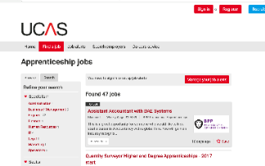
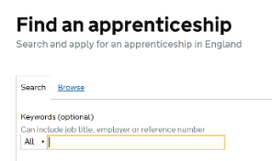




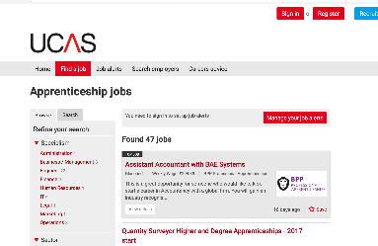
How do you find an apprenticeship?
1
4
Register on Find an apprenticeship
Manage
your alerts
2
5
Do your
research
Contact
companies
3
To find an apprenticeship visit
GOV.UK and search for apprenticeships
Search
and apply
Notes:
There are many ways to look for an apprenticeship, your main port of call will be the government website: find an apprenticeship. There you will be able to search and apply for the majority of apprenticeships available. You will also be able to set alerts for yourself to keep up to date and aware of relevant apprenticeship applications.

Slide 14





Where else to look?
WHERE ELSE TO LOOK?
Social media
Your friends and family
The company website
Notes:
Look on company websites if you were interested in a particular employer as they may have a private application form. Social media for companies are also a great way to keep up to date with apprenticeship vacancies. Don’t be afraid to reach out to family and friends about opportunities. My advice mainly is take initiative, you will need to keep on top of apprenticeship vacancies as they are constantly updating. Get your CV in order and reach out to a company yourself even if they aren’t looking for apprentices at the moment. Showing that initiative could get you in good standing with a company for future opportunities.

Slide 15

Hear from apprentices
Notes:
Presenter notes: If you have an apprentice ambassador with you, please replace this slide with their presentation
Delivery partner to insert film of their choice about apprenticeships
Depending on the audience, films that we would recommend considering showing here are all available on amazingapprenticeships.com
We would recommend that you download the film onto a memory stick and take it with you.
Some establishments will not have sufficient internet access
How to use Find an apprenticeship _ Short version (1m 17s) https://vimeo.com/152138038
Understanding apprenticeships _ Full version (4m 41s) https://vimeo.com/151121127
Technology apprenticeships for the new generation (4m 22s) https://vimeo.com/158818858
Higher and degree apprenticeships – make them your plan A (2m 58s) https://vimeo.com/173753735

Slide 16


Contact us
Follow the National Apprenticeship Service:
@fireitupapps
@Apprenticeships
Fireitupapps
National Apprenticeship Service
Search for apprenticeships on GOV.UK or call 0800 015 0400
Notes:
We know that this has been a challenging time for young people looking at their next steps and options for the future. Remember, there is lots of support out there to help to guide you into the right choice for you. You can contact the National Apprenticeship Service helpline. Remember you can also contact the National Careers Service, who can help to give you advice and guidance

Slide 17
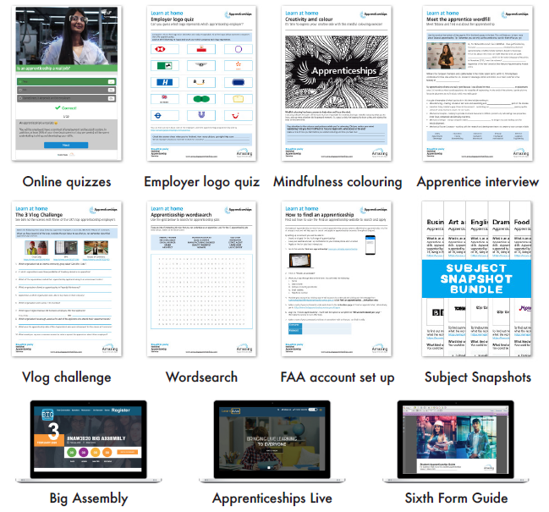
Amazing Apprenticeships
www.amazingapprenticeships.com
Notes:
If you would like to continue learning about apprenticeships, there are some brilliant resources available on the Amazing Apprenticeships website. Go to www.amazingapprenticeships.com

Slide 18

Notes:
As well as going out to schools to give information on apprenticeships, we also have our own recruitment department within the AIM group. If you sign up with us, we would be able to notify you if any apprenticeships that are relevant to your interests come up. We would then help you with the application process. If you got the apprenticeship we would stay in contact and check in to make sure everything is going smoothly.

Slide 19

Notes:
Here is a current example of a vacancy we are working to fill. Sign up with the AIM group and you will be able to apply for a whole variety of opportunities.

Slide 20

Thank you for watching
this presentation!
If you have any queries or concerns regarding
apprenticeships, please contact me:
Federica.bocchetti@theaimgroup.co.uk | 0203 900 3091
www.theaimgroup.co.uk | www.aimgroupfoundation.org
Notes:
Thank you so much for listening to my presentation today. If you have any questions please pass them on to your teachers who can forward them on and I can answer them ASAP.

